Slide 1
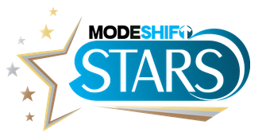
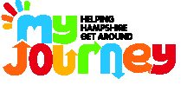

Modeshift STARS
Online School Travel Planning Tool
www.modeshiftstars.org
Helen Harris, Agata Blazevic, Angela Forsyth, Janet Foster, Amy Hartnell, Rachel Hazell, Sarah Lees, Angela Manore, Amanda Morris, Penny Noyce, Anna Ross.
Notes:
Welcome & Introductions
Travel team introduce themselves
To get a feel of where people are with STARs - participants introduce themselves –name, role in school, level they are at with STARS.
Check logins
Participants should have already requested logins. Participants to login with own logins or team to set them up as required. Should be completed in advance of session.
STARs Awards in Hampshire
So far we have had 2 schools in Hampshire accredited at Green, 36 at Bronze, 13 Silver and 17 Gold Schools. One of our gold schools won SE and E Regional school of the year in 2015 and best Sustainable Transport Initiative by an Educator (National Modeshift Award). Hatch Warren Infants won southern regional award (2017) and Oakridge the national award for Excellence in Walking (Modeshift). Forest Park also won Hampshire and National SEND School of the Year 2019.

Slide 2
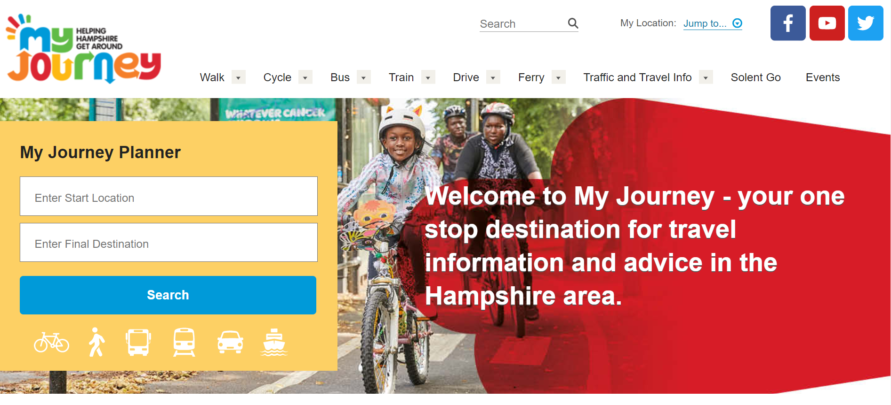
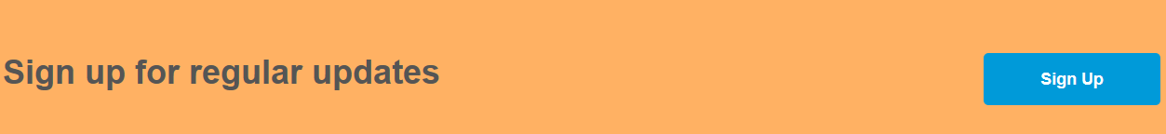
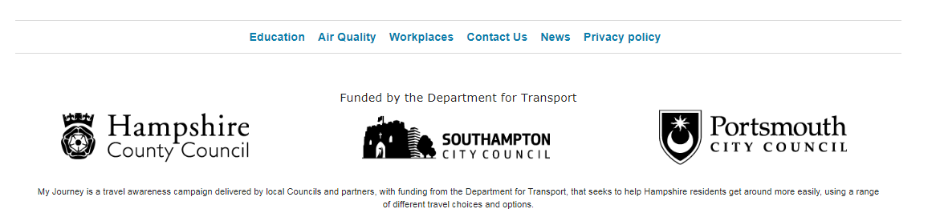
Sign up to Newsletter
Notes:
Go on to https://myjourneyhampshire.com Click on the link at the bottom of any page to receive our electronic newsletter.
To find the education pages, go right to the foot of the main page and look for the headings “Education, Air Quality …”

Slide 3


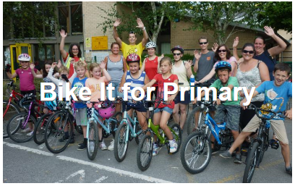
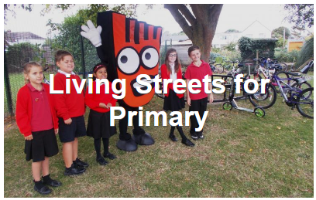
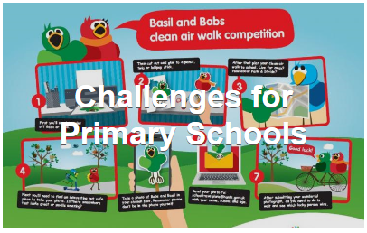
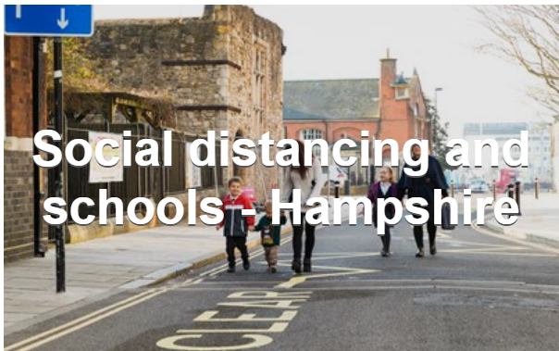

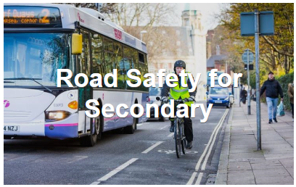

Curriculum Resources & Challenges
Notes:
Being schools, teaching is what you do best and the best way of achieving behavioural change is through the curriculum.
Go through the pack of information given out to candidates – also available electronically.
My Journey website (https://myjourneyhampshire.com/education/) – resources available for primary/secondary schools. E.g. lesson plan for scooter training, Air Quality/Walktober resources etc.
Participants can help themselves to any literature on the display table.

Slide 4
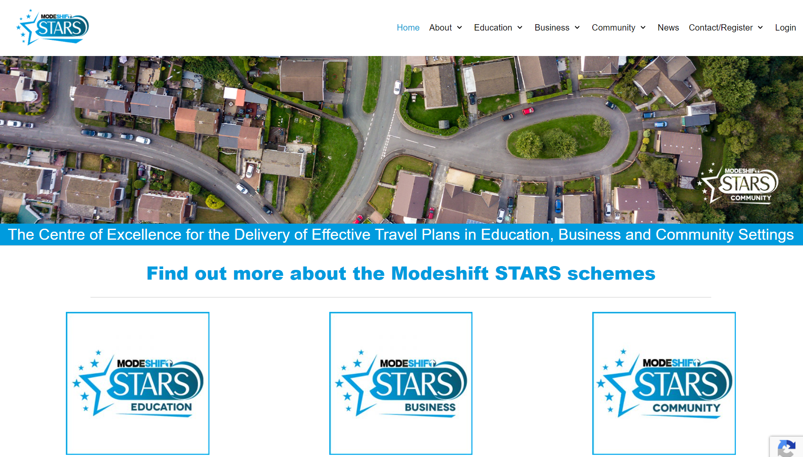
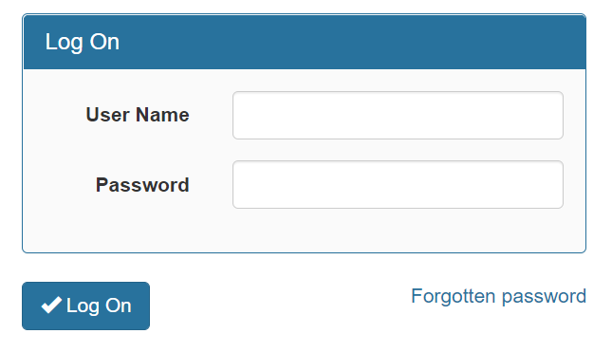
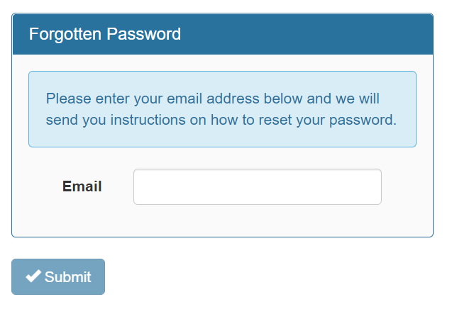
Notes:
Point to note – sometimes there is a problem with certain browsers when accessing the information – try a different one, Chrome usually works best.
Homepage of STARS page
Register at the top right hand corner – under contact/register. Enter your details in the STARS Schools Contact section – it will take up to two days for registration to be completed (we will receive your request and then need to complete the process). You will receive an email from eim@excelpoint.co.uk once the process is complete.
Once you have received your registration details you can logon using the logon button top right (Education user). You will need to enter your username (the email address you registered with – ideally a school email address) and password (which you will already have set during registration).
You can have as many logins as you want – good idea to get your HT to log on and involve the SMT. Perhaps an admin contact too or LSA/TA.
If you forget your password when you log in click on ‘Forgotten Password’ – another box will come up where you enter your email and press ‘submit’ to instigate password reset.
The front introduction page also has upcoming dates of local events and a brief intro.

Slide 5
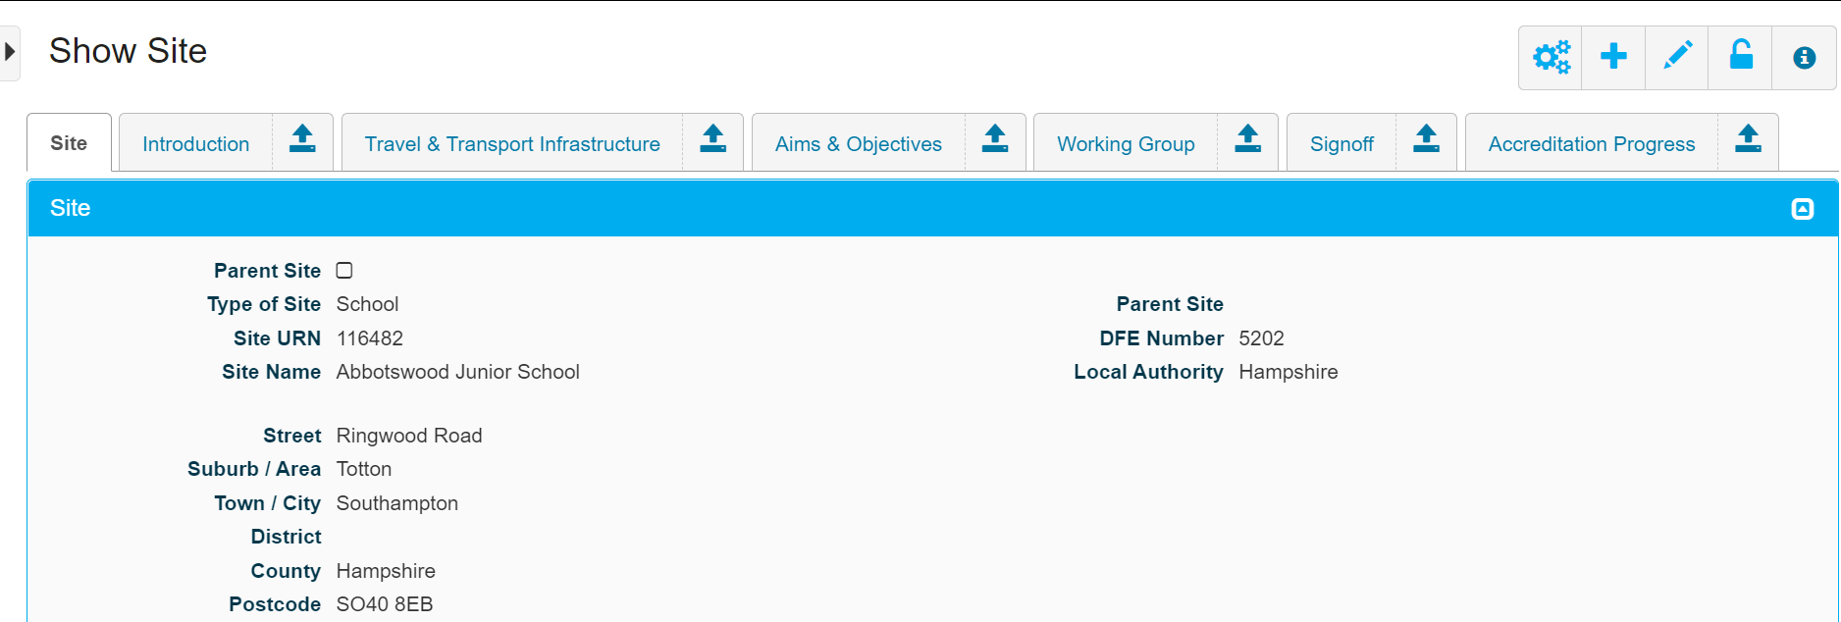
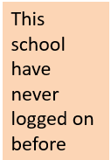
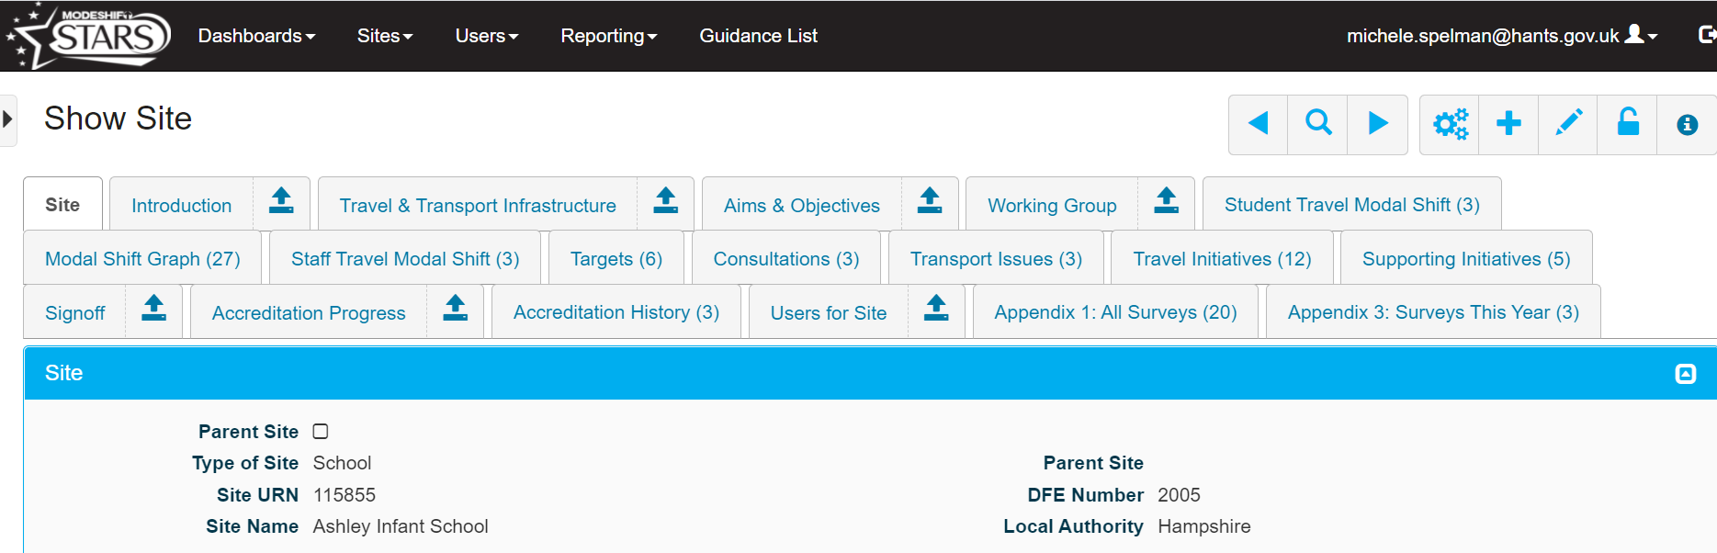
This school have achieved bronze level STARS – note the extra tabs along the top
Notes:
Once you have logged in, this is the landing page you will get. This page will develop as you add more information.
From here you can use the guidance tab in the black banner at the top to download more resources.

Slide 6
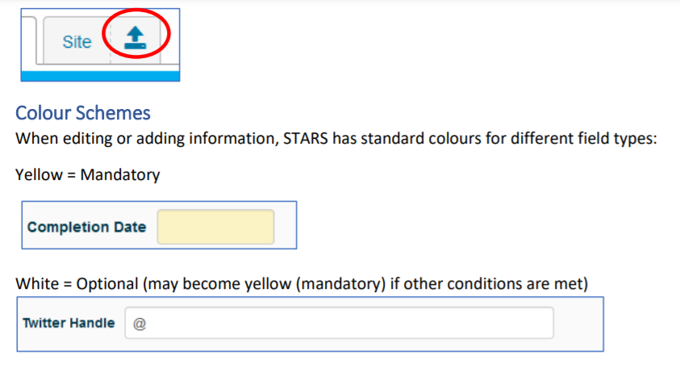
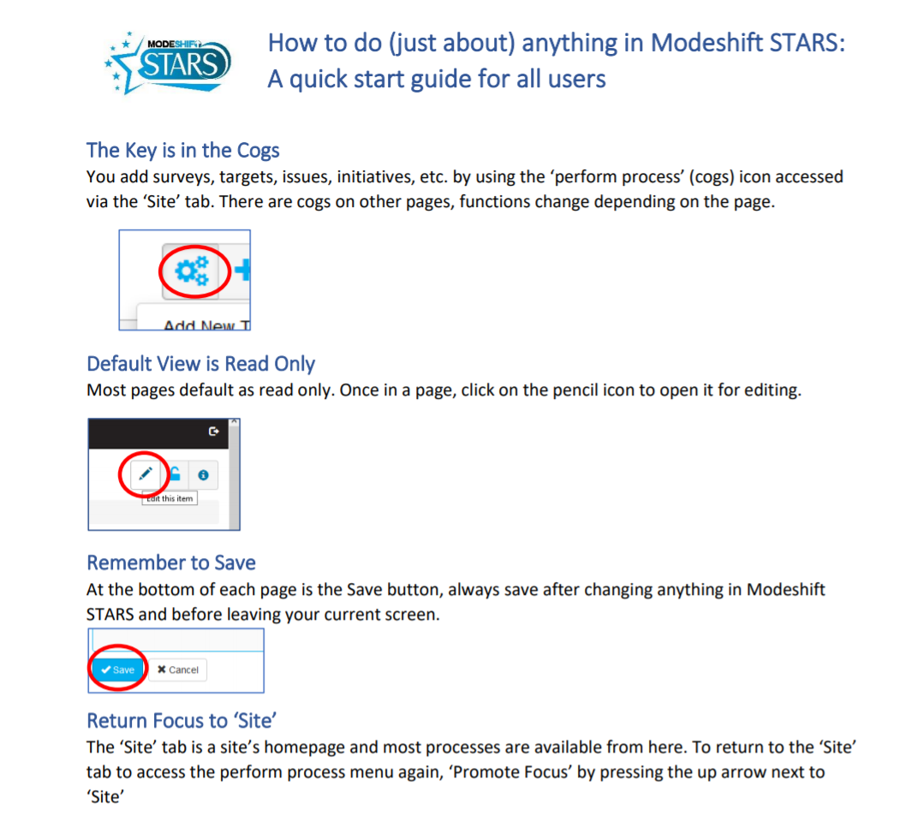
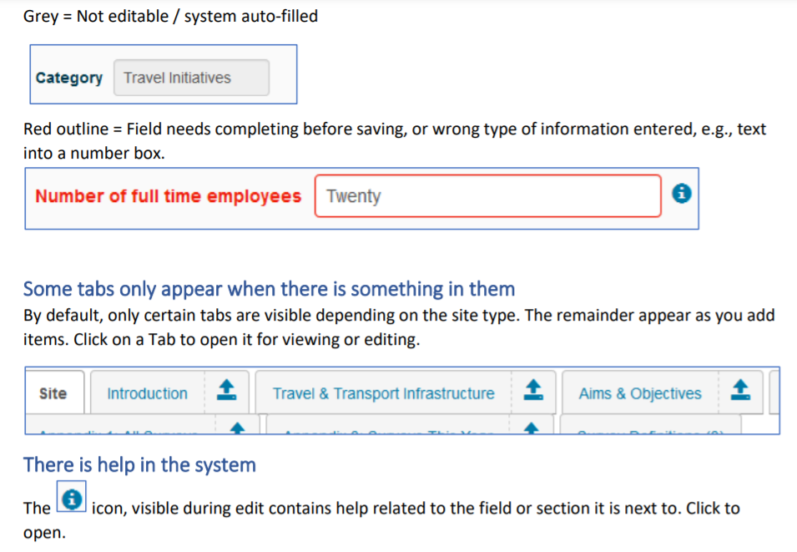
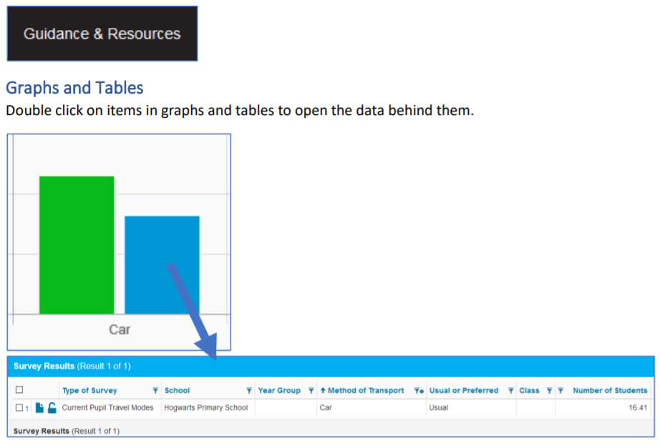
Notes:
You have a copy of the ‘How to do (just about) anything in Modeshift STARS’ guide in your folder and this can also be downloaded from ‘guidance tab’ in the black bar.

Slide 7
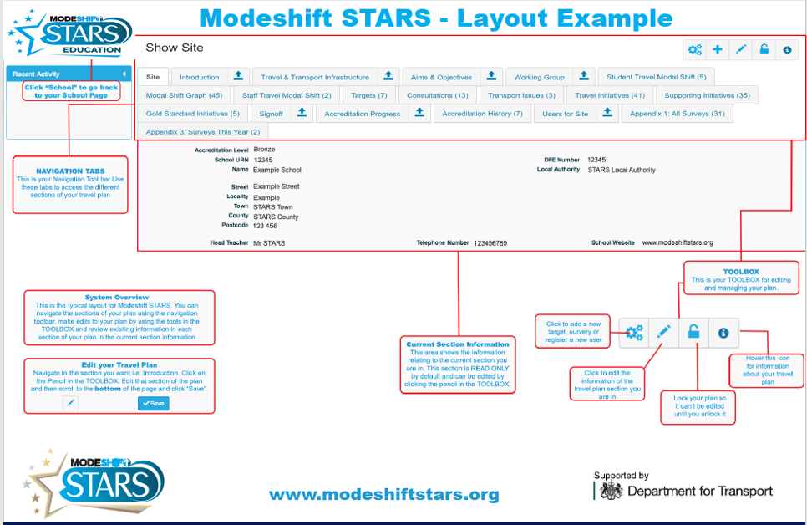
N touch
Notes:
The STARS pages work from a horizontal menu and you can use the tabs at the top of the page to move through each section.
To edit your plan, use the pencil icon in the toolbox (top right of the page) once you’ve accessed the relevant section. Once you have completed your edit of a particular page, PRESS SAVE (at the foot of the page). Your work DOES NOT SAVE AUTOMATICALLY.
This page explains what each of the areas of the website is for. To return to your main school site homepage, click on the ‘Site’ tab – you will need to do this to add new/editing existing information using the toolbox.
On the toolbox, the cogs are for adding survey, target, transport issue, consultation, travel/supporting initiatives, gold standard initiative, funding secured, register new user, generate survey user, gold testimony and working group member. Also to generate a PDF of your school travel plan, walking bubble map, planning application, set parent site and unlock school records.
The pencil is for editing the tabbed page you are currently position on.
The lock button locks your plan so that it can’t be edited until you unlock it.
The information button shows when your pages were last updated and by whom.

Slide 8
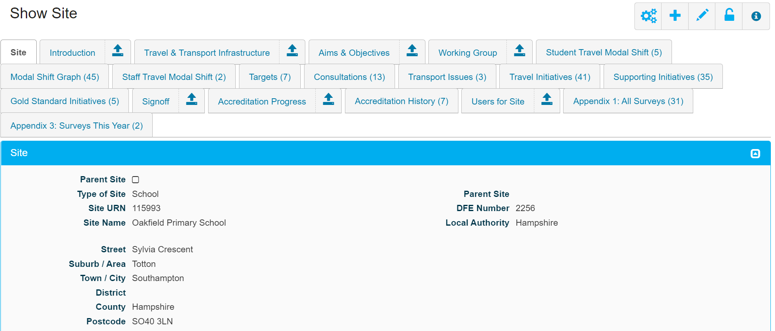

Edit School Site Details
Click on the pencil again to edit
Notes:
Update as required. Then SAVE!

Slide 9
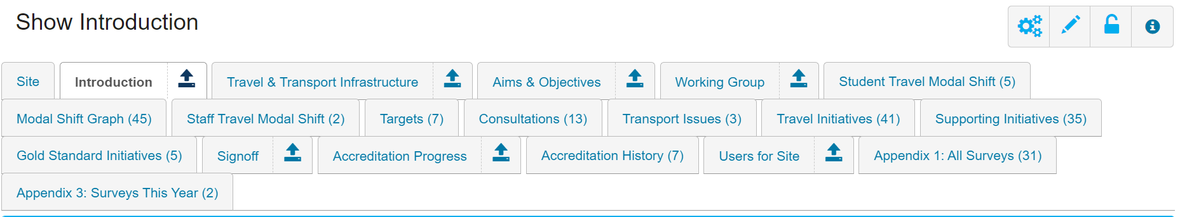
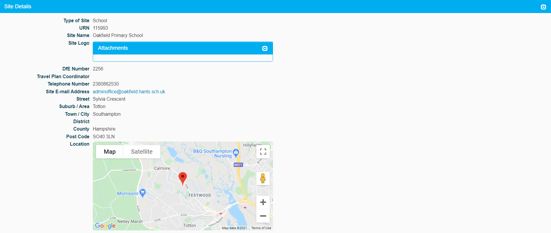
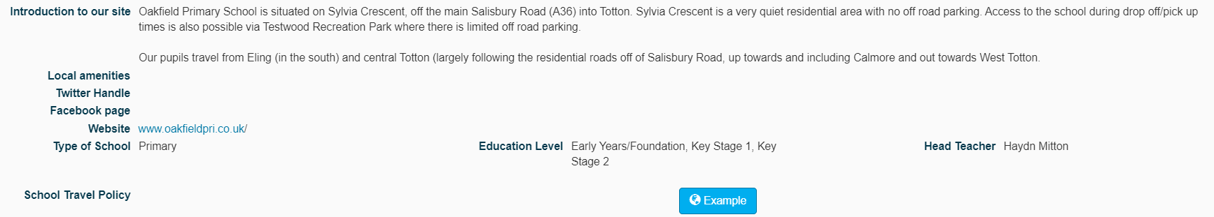
Introduction: School Information
Click on the pencil again to edit
Notes:
Section headings:
Site details - Add information about the location of the school and add school logo (optional)
Note you can download an example of a School Travel Policy here
Continue to scroll down the page

Slide 10
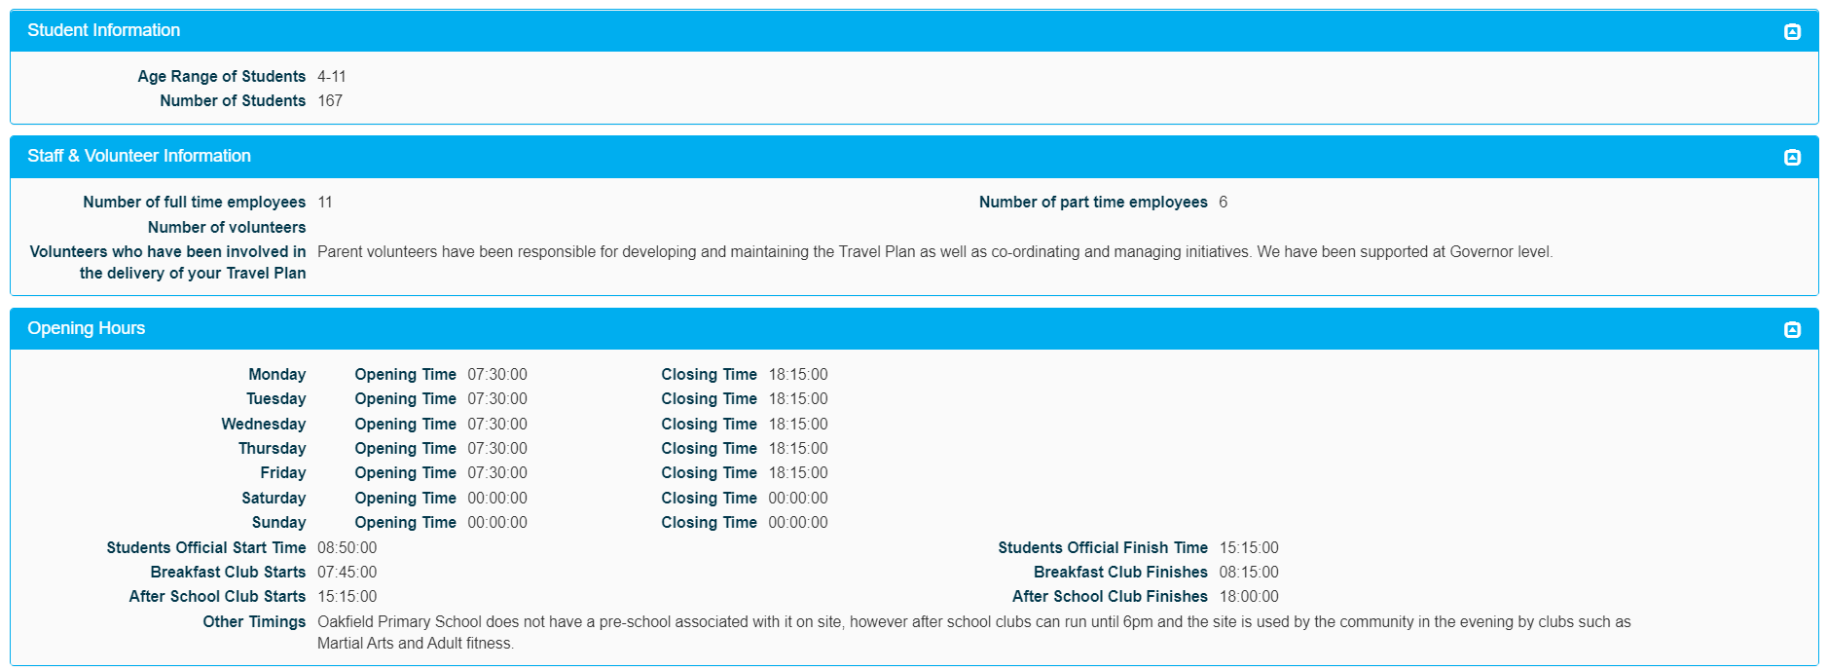
Introduction: School Information
Notes:
Pupil and staff information
The Pupil and Staff numbers are important, as this is what the system uses for calculating the percentages for modal split and response rates for Hands up surveys.
Opening Hours – site, pupils hours, out of hours care. The school may be open different times each day – this information can be noted here.
Continue to scroll down the page

Slide 11
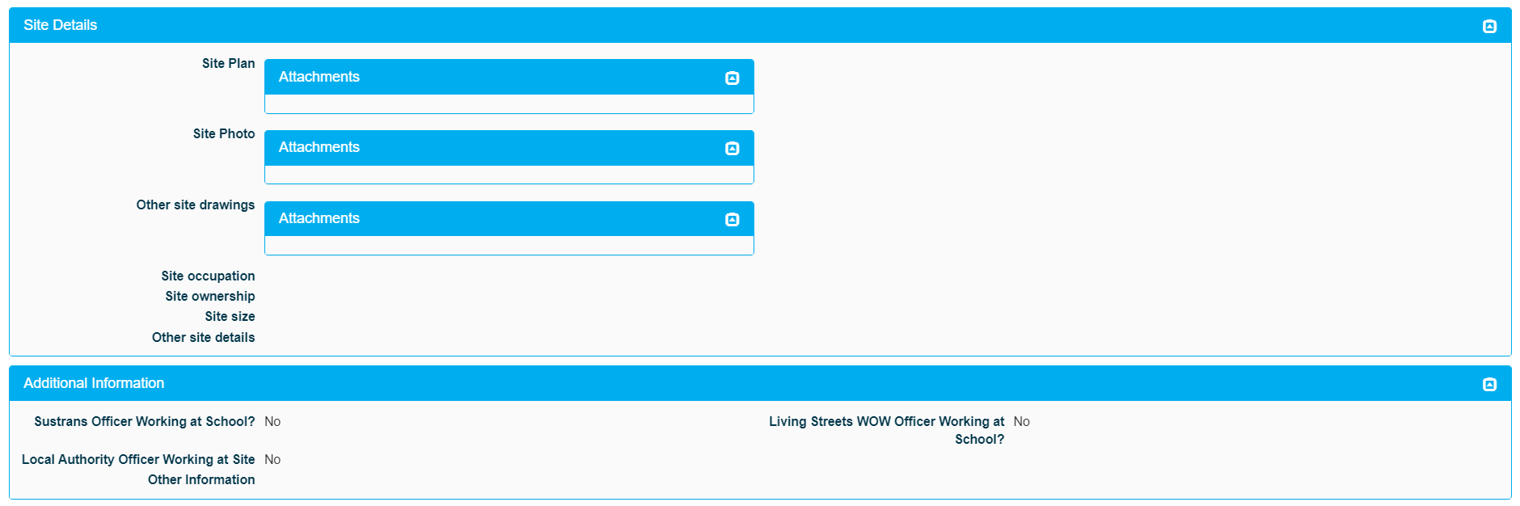
Introduction: School Information
Notes:
Site Details – Add site/school plans, photos, other drawings (maybe school has or is to be extended/new landscaping planned or completed, changes to accesses) can be added. Add information about school site occupation (shared site with other schools) ownership (e.g.HCC) size of and any other information about the school site.
Additional Information – add details of other staff involved in travel planning attached to the school e.g. Sustrans officer

Slide 12
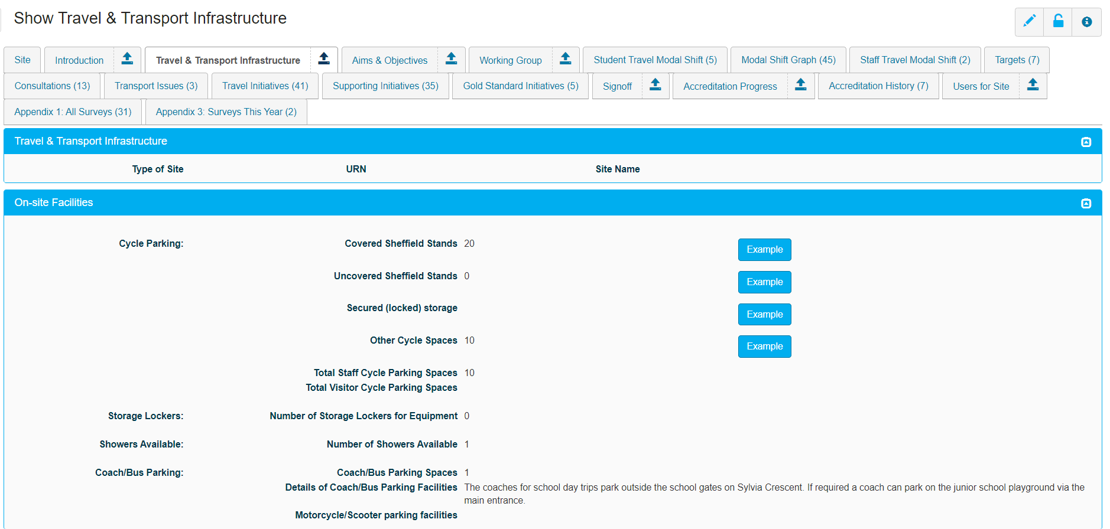
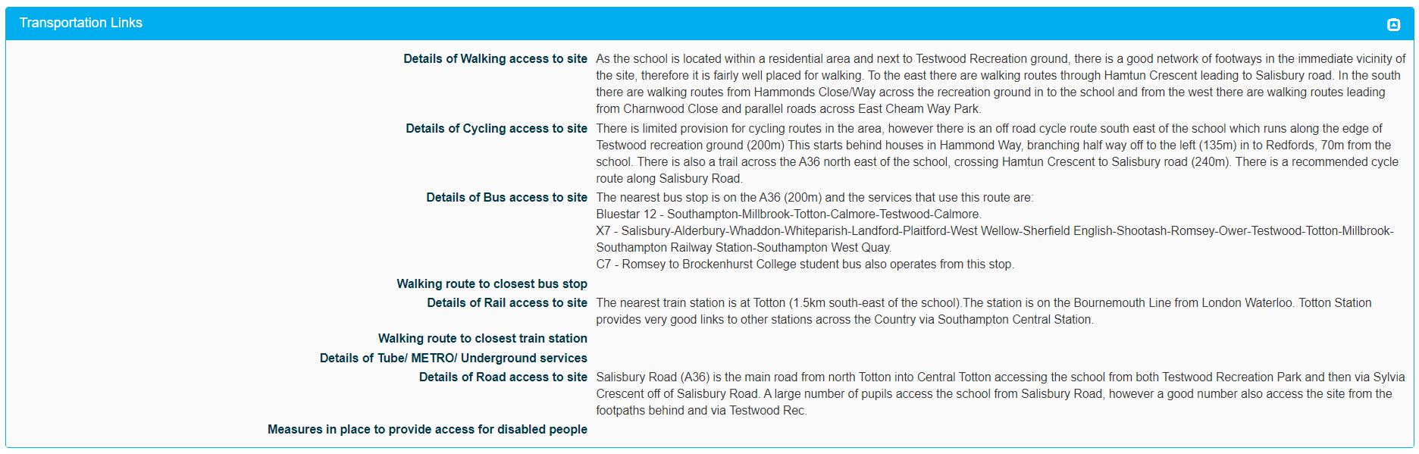
Travel and Transport Infrastructure
Click on the pencil to start entering information
Notes:
Click on the pencil icon to start editing
On Site facilities – add information about cycle parking (click example buttons for photos of different types of cycle storage) and coach parking. Does your school have any shower facilities or storage lockers – cycle helmets etc.
Transportation Links - This section is about adding information on your local area. It’s useful to publicise some of this information (bus routes / times) on your school website if you want to encourage people to use bus services rather than cars. Add details of access parking spaces and other facilities.
Mostly this is about local infrastructure but might help you find options for Park and Stride car parks etc.

Slide 13
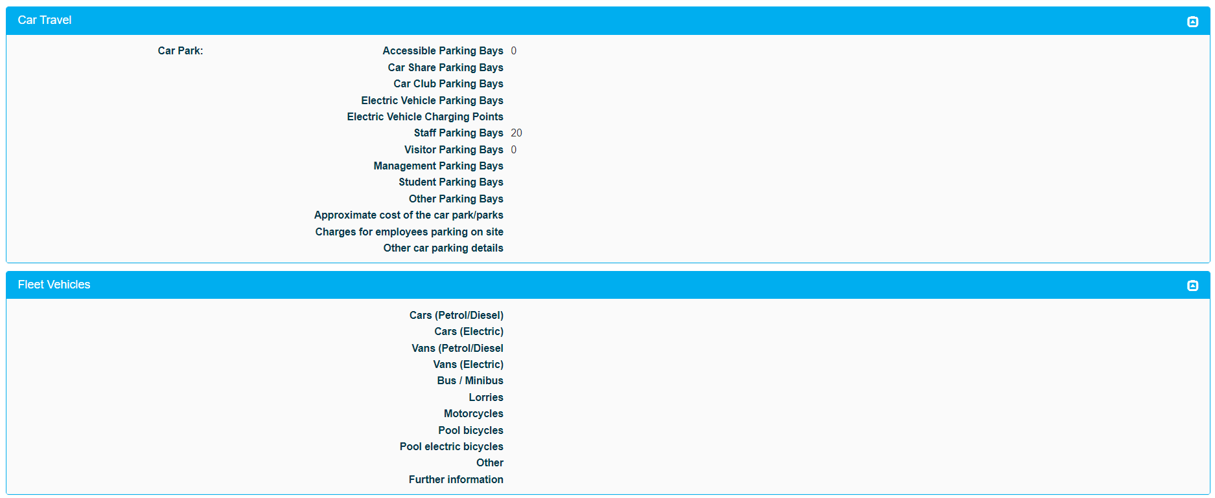
Travel & Transport Infrastructure
Notes:
Car Travel – details of types of on site parking and off site car parks near your school/college. Electric charging points on site.
Fleet Vehicles – cars/vans/bikes etc. if applicable
All this information is optional – not required for accreditation purposes.

Slide 14
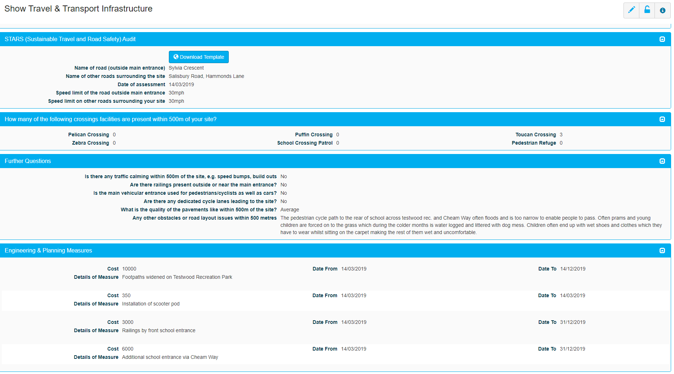
Travel and Transport Infrastructure
Notes:
In this section a site audit is required – (example of this on next slide) This exercise could be completed by JRSOs/School Council. Add information on speed limits, crossings, parking, cycle lanes etc. Information concerning engineering works to the school site – new pathways/gates/parking facilities/ can be added in this section.

Slide 15
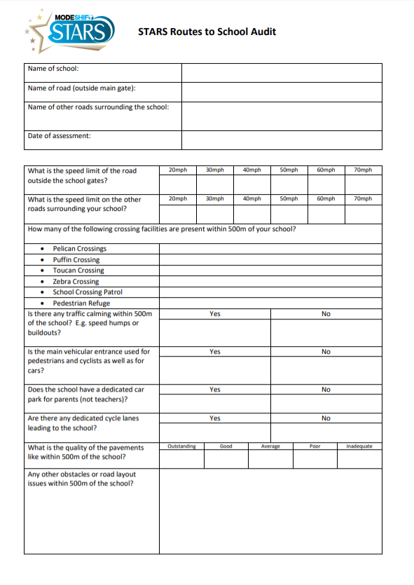
Travel and Transport Infrastructure - Route to School Audit
Notes:
Press 'Download Template' Tab for Route to School Audit form.

Slide 16
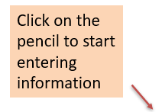
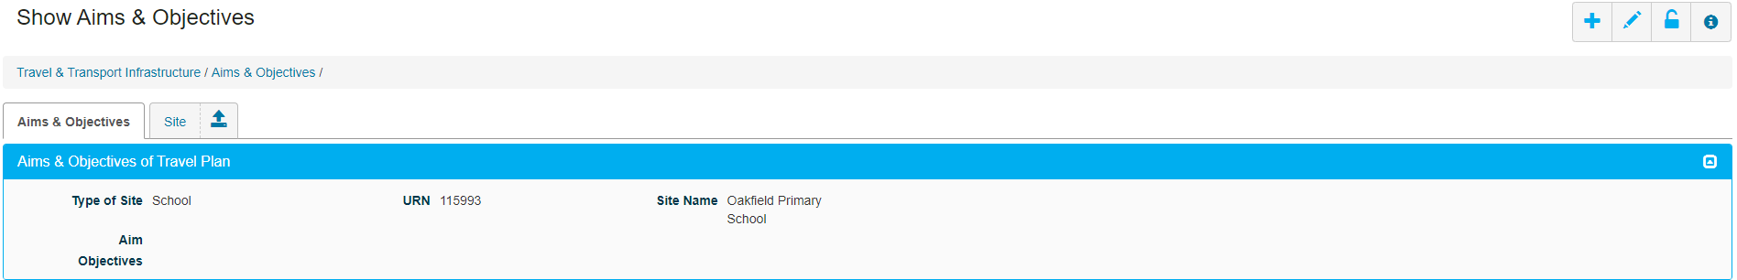
Aims and Objectives
Notes:
The aims of a Travel Plan should reflect broadly what you want to achieve. For example, a main aim could be: To manage school travel in a safe and sustainable way.
Your objectives should help you to achieve your overall aim, e.g., to reduce traffic, increase active travel, improve levels of health and well-being, improve facilities, increase safety.

Slide 17
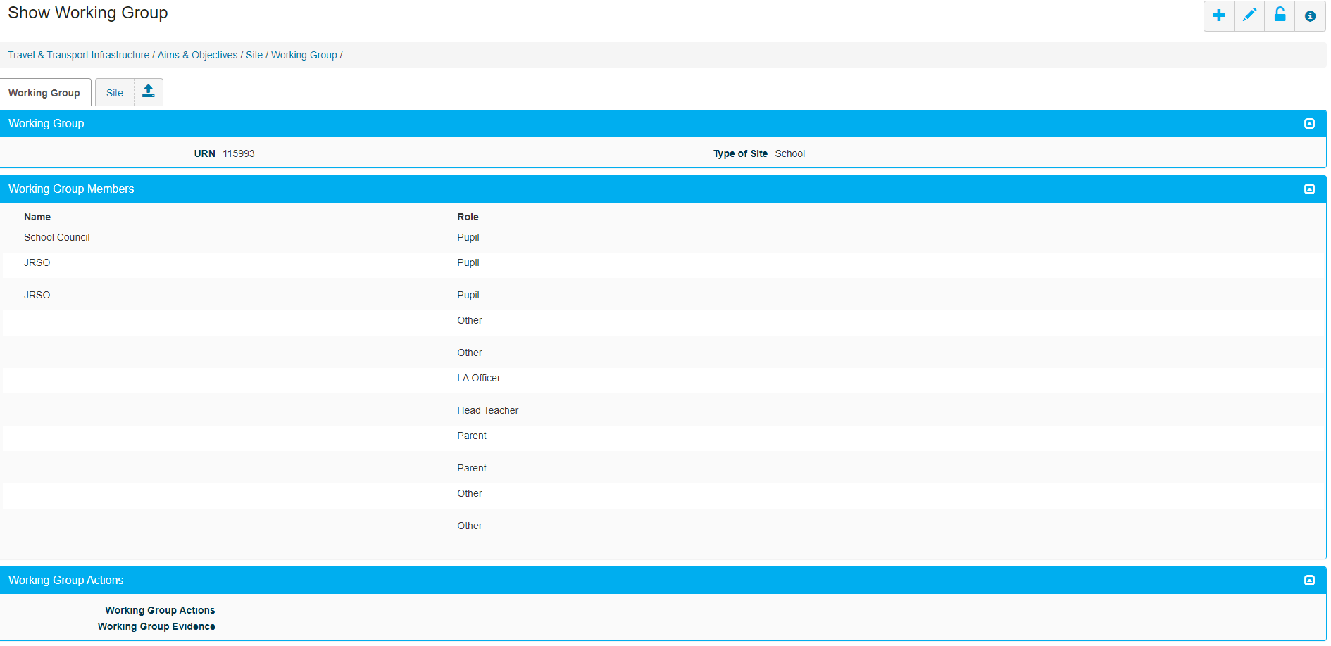

Working Group
Notes:
Working Group
There is now a separate tab for Working group, however this does not automatically appear on existing plans for schools nor does it still show under the introduction as it did previously. If the Working Group tab is missing for your school, all you need to do is edit either the ‘site’ tab or the ‘introduction’ tab and then press save. You do not have to make any alterations to either page just simply press the pencil and save.
In order to achieve Modeshift STARS Silver, Gold and Platinum level accreditation your school must have a School Travel Plan Working Group and evidence that they have met/worked towards the plan. Although not required for Bronze level, it is best practice to have a Working Group to share responsibilities and workloads. This section allows you to list members of your working group, record actions and upload evidence, e.g. meeting records. Modeshift advocate that the Working Group should consist of members of the senior management team, teachers, Governors, parents and pupils. For silver there needs to be a minimum of two staff members and 2 pupil groups e.g. school council, JRSOs You are responsible for ensuring that you have appropriate consents for any photographs, images or personal information that you upload to Modeshift STARS.
Modeshift strongly recommends that you do not include student/pupil names within Modeshift STARS. We suggest referring to them by group title, e.g. JTA, YTA, Pupil Council, etc. where appropriate.
At the end press SAVE!

Slide 18
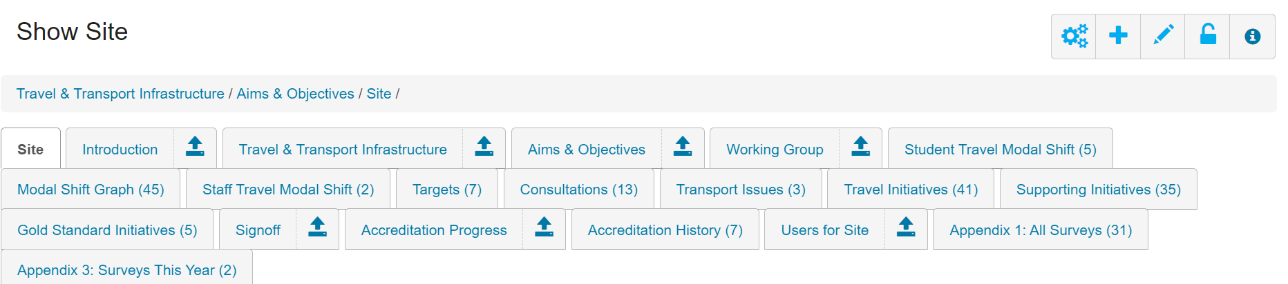
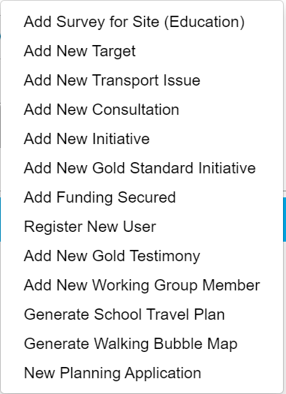
Adding new tabs
Click on the cogs
Notes:
The cogs are there for adding in new information – to get to the cogs menu always click on the 'site' tab.
On the toolbox, the cogs are for adding:
New survey – where to enter the results of your annual ‘hands up’ survey
New Target – once you have reviewed your survey results, enter two annual travel targets.
New Transport issue – add information about congestion, parking, speeding outside the school.
New Consultation – enter 2 for green/bronze, 7 for silver and 10 for gold/platinum levels.
New Initiative – add information about travel and supporting initiatives e.g. Walk to School Week, Cycle Storage, Promotion of activity in school newsletter, Induction packs for new parents etc.
New Gold Standard initiative – where you demonstrate that your school has excelled in promoting walking/scooting, cycling, road safety, air quality or public transport to achieve gold STARS level.
Funding Secured – Opportunity to add details of any funding you have received in respect of walking, cycling, air quality activities etc.
Register New School User – this is where you can add those working on the travel plan so they can access the STARS system. You can have as many users as you wish. Secondary schools often involve pupils/students in updating the travel plan. (pupil/student view can be arranged).
New Gold Testimony – This is where you provide a testimony that justifies why you should receive STARS Gold standard accreditation based upon the initiatives that you have delivered and the impact that they have achieved
New Working Group Member – Add names of people involved in the travel plan – HT, TA, Parents, Governor, Local Cllr.
Generate PDF of School Travel Plan – You can click here and view or download a copy of your STARS travel plan to include on your website, email to parents and visitors to the school, use to support planning applications.
Generate walking bubble map - The idea of the Walking Bubbles is to create voluntary car-free zones around schools, encouraging everyone who can to ‘Get Active’ on their journeys to and from school. Click here to create a Walking Bubble Map for your school
New Planning Application - If your school has submitted or is planning to submit a planning application for expansion you can enter details about it in this section, site plans, note changes to the site and possible changes to opening hours etc.

Slide 19
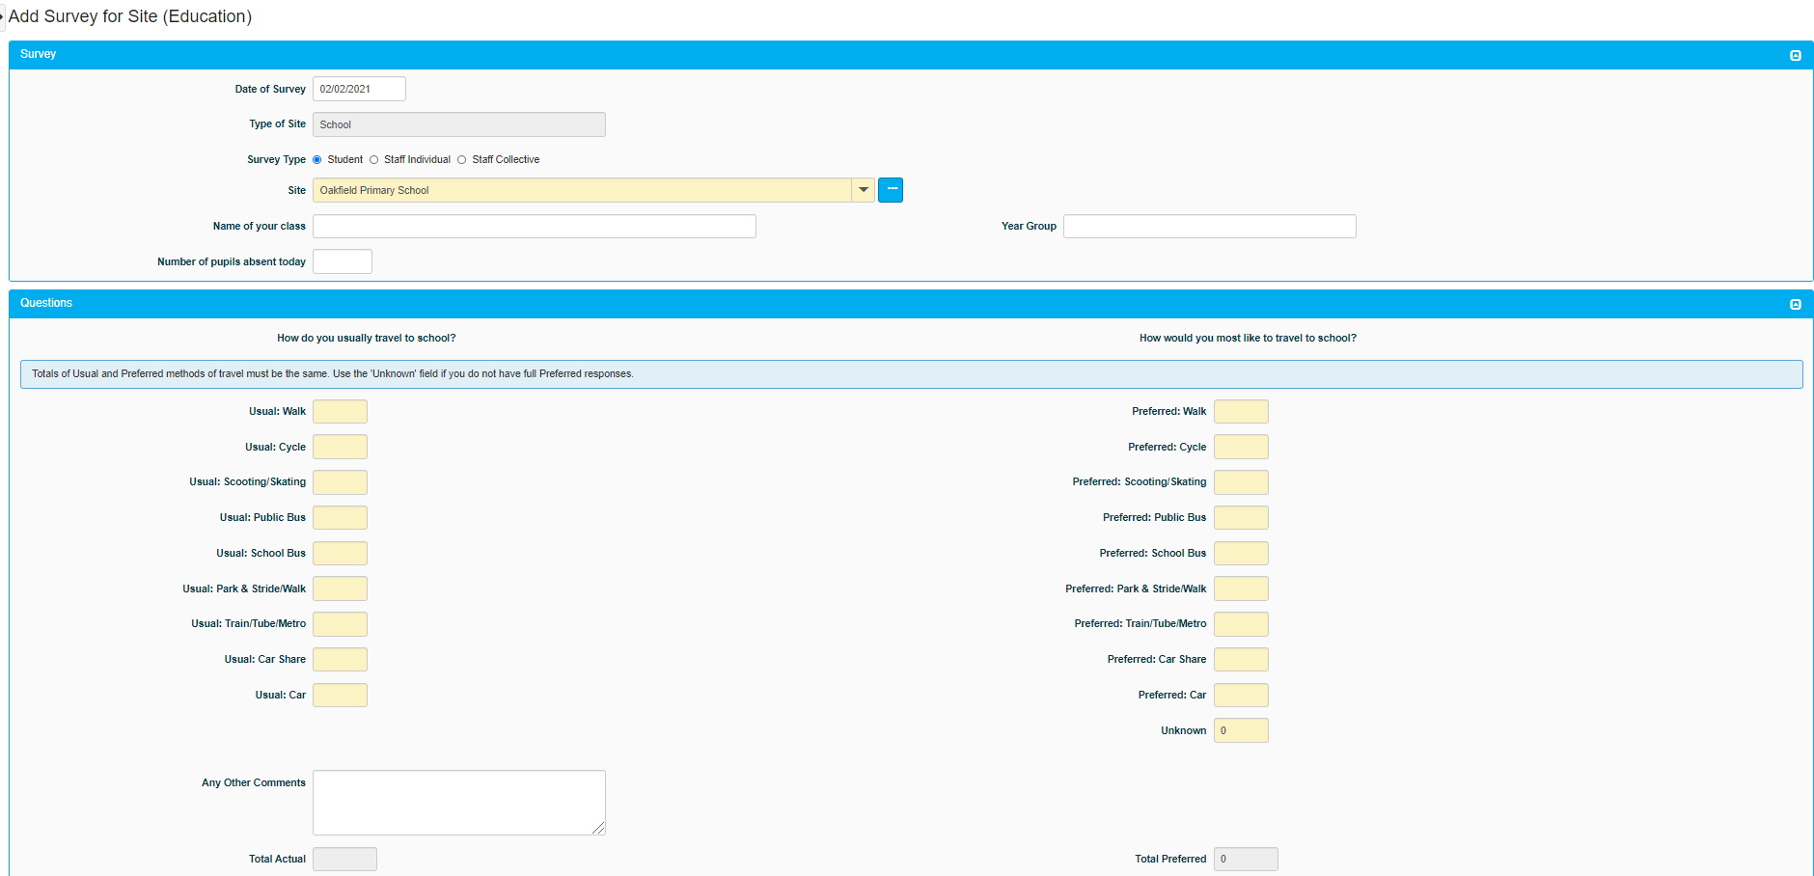
Adding a new survey
Notes:
In the guidance tab at the top – there is a guide on how to add a whole school survey. To achieve accreditation a ‘hands up’ survey needs to be carried out each year. For the survey responses to be valid, an 80% response rate from pupils (70% for secondary schools) and at least 50% from staff is required(teachers, SLT, admin, TAs, site staff). Don’t pick a week when several classes are out on a school trip! For a true picture it is best if all classes do the survey on the same day and preferably the same time each year.
Also, be aware that the percentage response rate is based on the total number of pupils entered in the introduction section so the two should tally up.
Please note: To achieve silver there needs to be any modal shift away from car alone use . Gold requires a 5% shift away from car alone use over four years and Platinum an increase in active modes of travel (walk, cycle, scoot) for the whole journey to school of at least 5% in four academic years.
Use the cogs icon to add a new survey – this screen will show. You can choose to add for individual classes, individual staff members and a whole staff.
You must note the number of pupils absent at the top so that, if there are 30 pupils in the class and one away, you only enter 29 responses to the two questions: How do you usually travel to school? How would you like to travel to school?
Please note that the number of responses to these two questions MUST add up to the same number i.e. 29 in each column if there are 29 pupils that day.
You should enter each class separately. If you want staff to enter their classes themselves, see the next page for instructions.

Slide 20
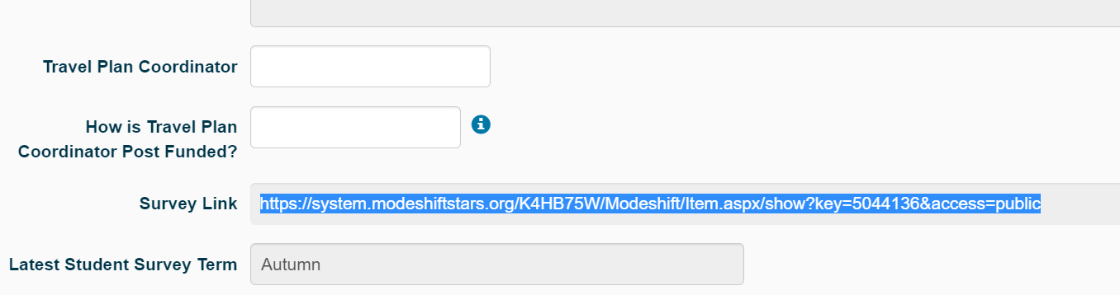
If you want staff to conduct and input the surveys themselves…
Notes:
You can collect paper surveys and input them through your own login.
If you want staff to input the surveys themselves you can share the Survey Link which is located on the ‘Site’ tab.

Slide 21
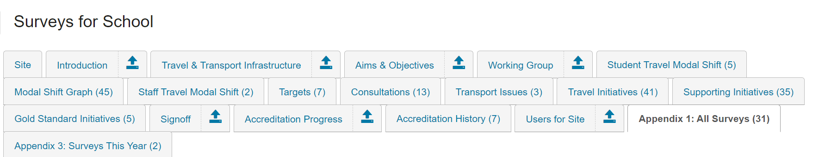
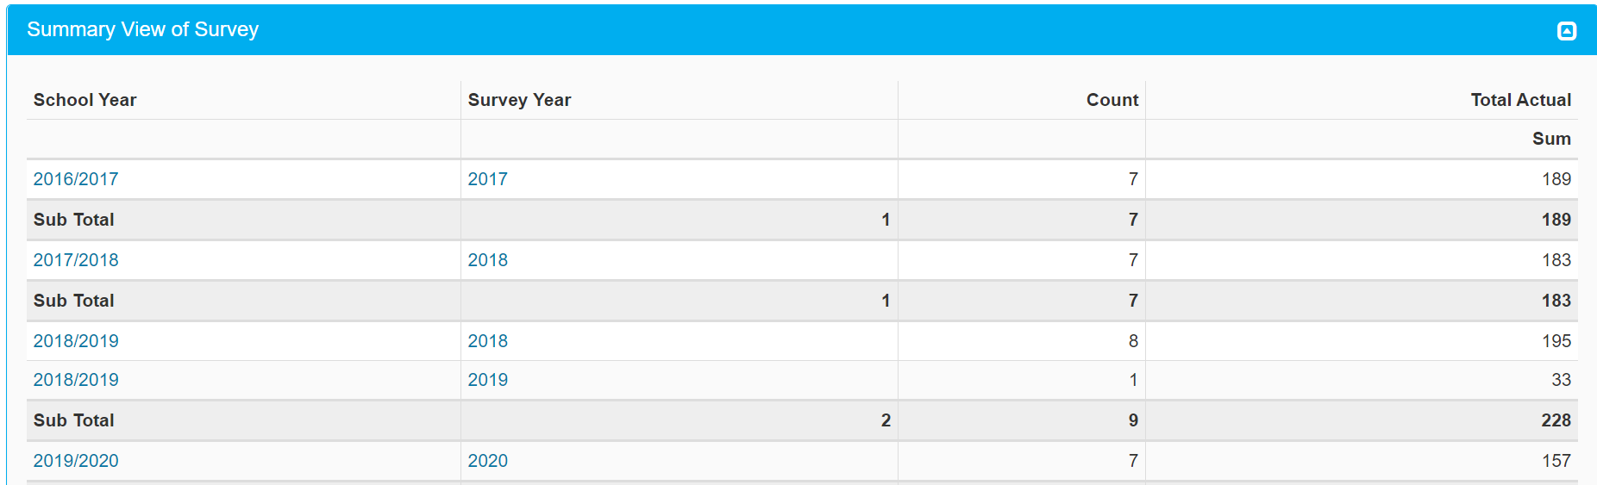
All Surveys
Click on year to see details of survey
Notes:
Click on the year to show details of the survey – next slide

Slide 22
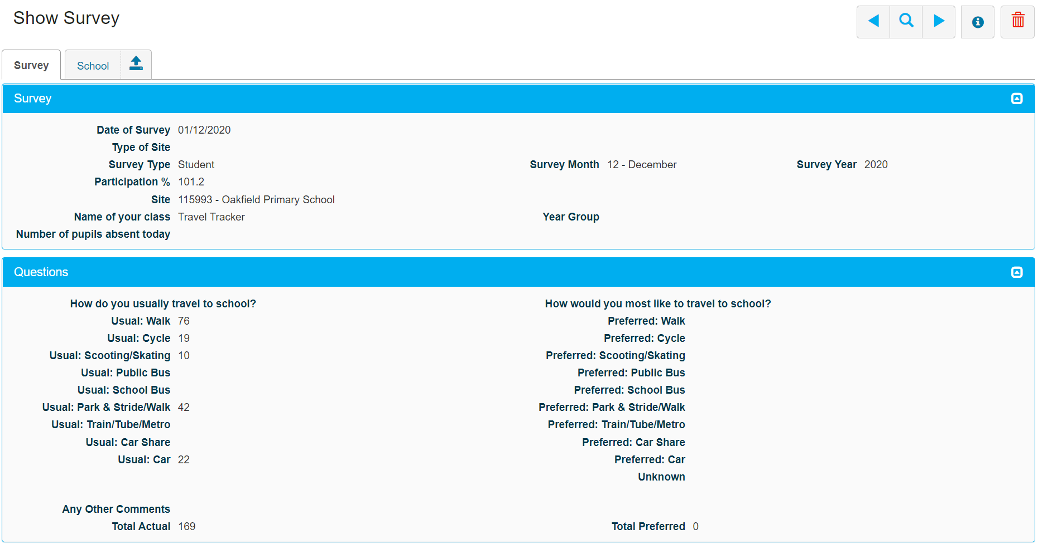
All Surveys (cont.)
Notes:
Survey details. Click on arrow key next to ‘school’ to go back to ‘landing’ page.

Slide 23
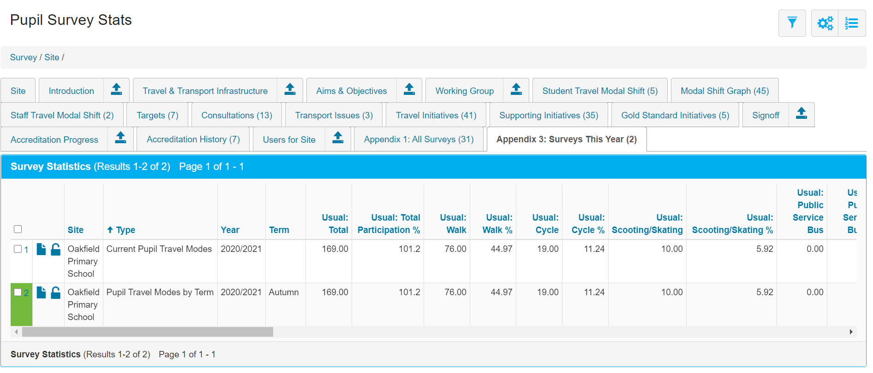
Pupil Surveys This Year
Click here to show details of survey.
Notes:
This tab shows details of surveys in a current year. Results of the two questions asked ‘How do you travel to school?’ and ‘How would you like to travel to school?’

Slide 24
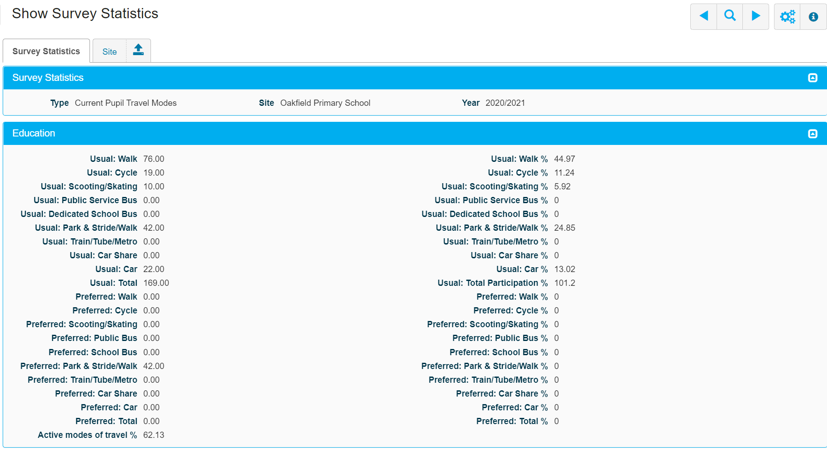
Pupil Survey Statistics
Notes:
Click on the survey to see the pupil travel data by mode of travel - calculated by number and percentage.
Historical travel data currently only goes back to 2016/17 – data for other years will be added in the future where it is available

Slide 25
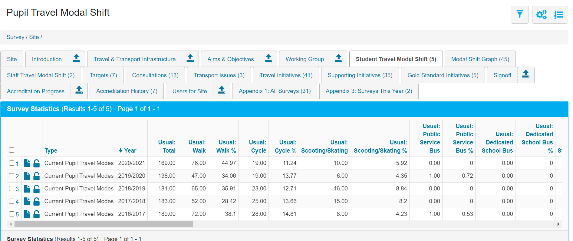
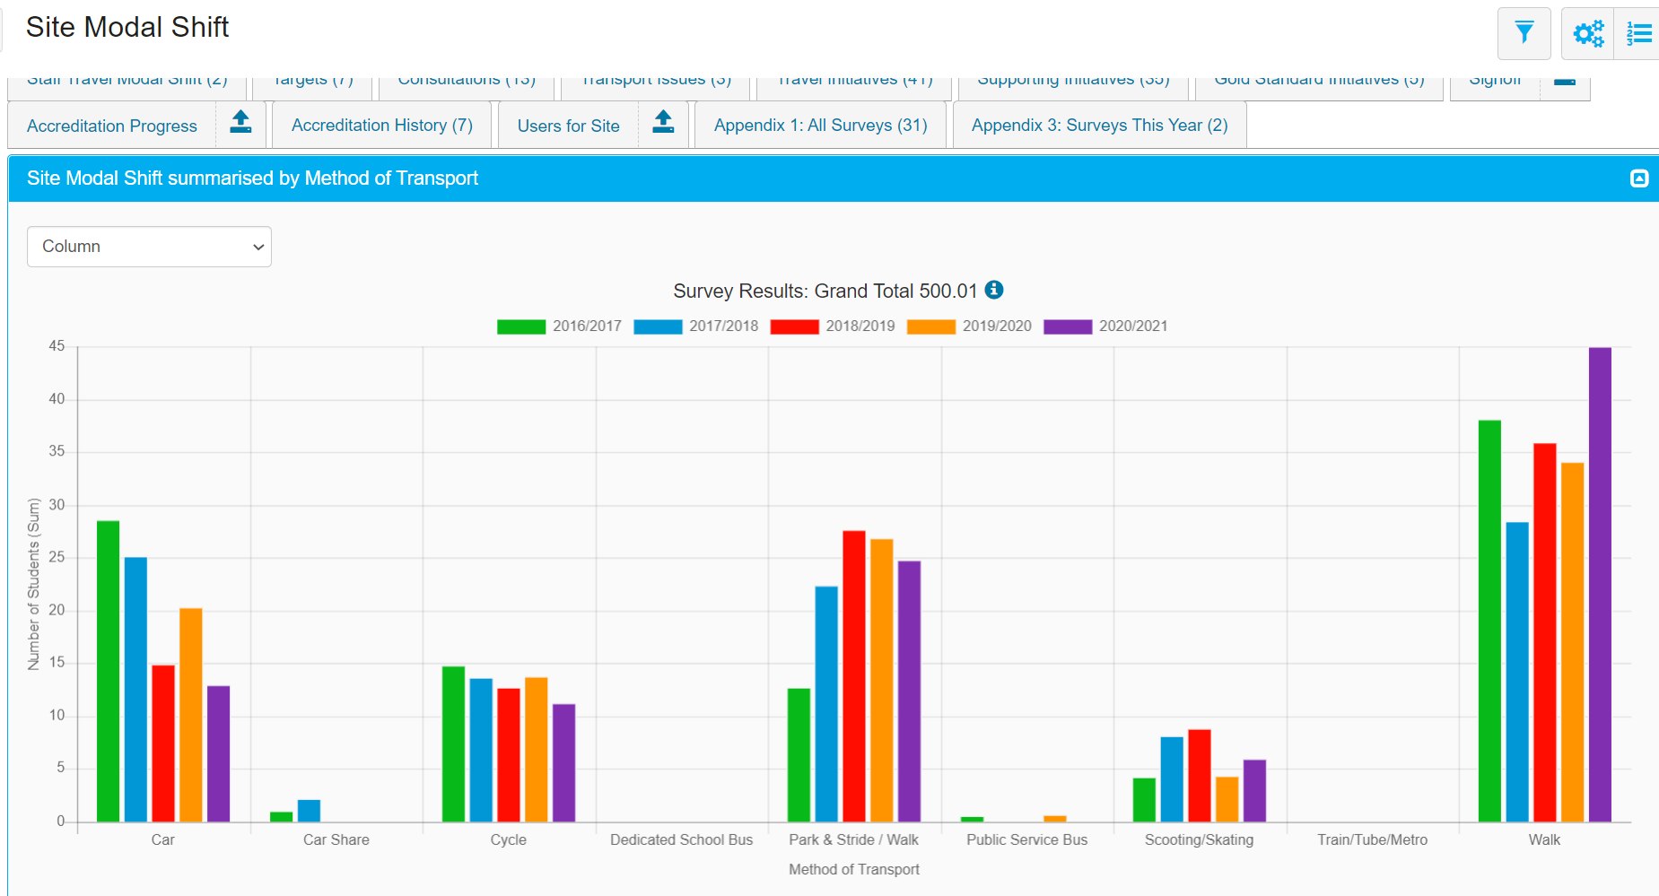
Student Travel Modal Shift
Notes:
Pupil/Student mode of travel data is now available in table and graph format. There is new tab ‘Modal Shift Graph’.
Schools will only get an annual figure in the ‘Pupil Travel Modal Shift’ tab if their survey hits the 80% response rate for pupils and 50% for staff.
There is a separate tab for ‘Staff Travel Modal Shift’ – only available in table format. Staff survey details can be found in ‘All surveys’. Staff modal shift is not part of the accreditation criteria.

Slide 26
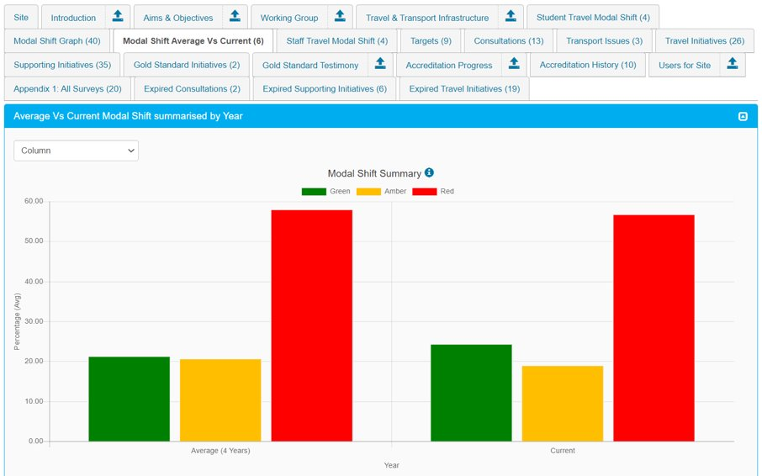
Average Vs Current Modal Shift​
Notes:
All modes of travel are grouped into Green, Amber or Red modes for calculating accreditation:​
Green: Walk, Cycle, Scoot/Skate​ Amber: Public Bus, School Bus, Park & Stride/Walk, Train/Tube/Metro​ Red: Car, Car Share, Motorbike/Scooter(motorised)​
​
The modal shift rules compare the current year’s student survey against the average of any surveys carried out in the previous three years. This clarifies when a school qualifies for the next level accreditation if travel modes have moved up and down or down and up across survey years, or the school missed a year. A new tab ‘Modal Shift Vs Current’ has been created to display this. ​
​
Improved calculations for qualifying for Excellent (previously Gold) or Outstanding (previously Platinum) Travel Plans. Modal shift requirement is now 5% rather than the previous 5 percentage points. This particularly helps schools with already low levels of red travel modes and those looking to renew their accreditation. ​
​
For example: ​
under the old rules a school with 20% red modes use would need to reduce to less than 15% whereas a school with 95% would need 90%, which is much easier to achieve from such a high base line.​
under the new rules a 5% red mode reduction would take the 20% site to requiring 19% or less. The 95% school would need 90.25% or less so the challenge for both should be similar.​
​
The Accreditation Progress tab shows the rules and explain Green / Amber / Red groupings.​

Slide 27
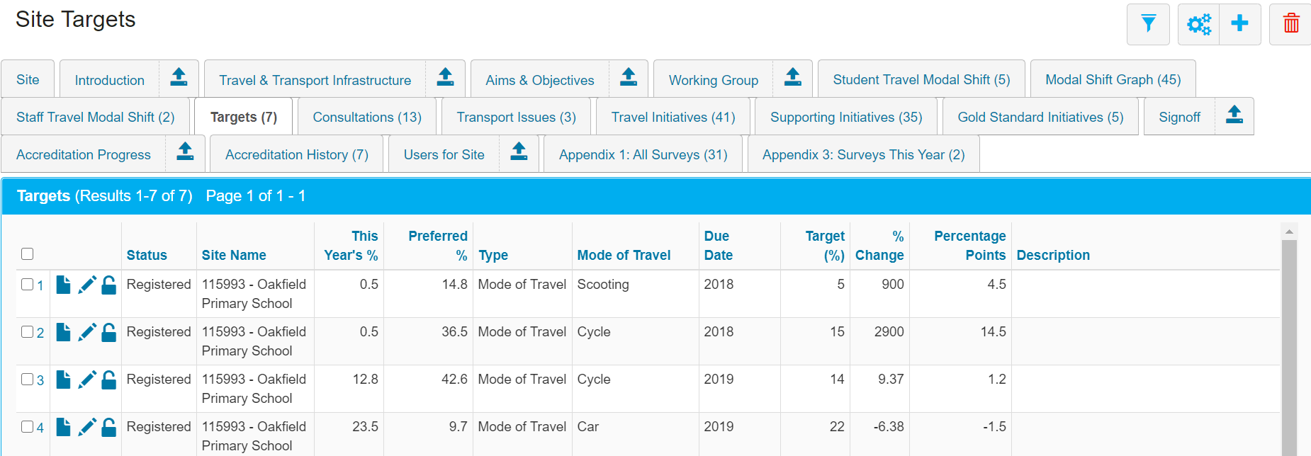
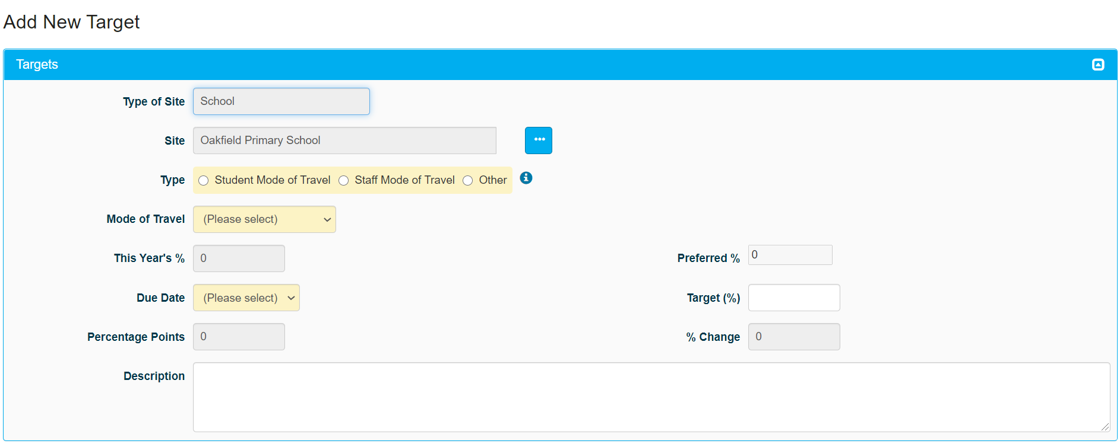
Setting targets
Add new targets using the cogs. You need to select if pupil/staff/other and then select the required target.
Notes:
Options for type of ‘mode of travel’ target:
Walk
Cycle
Public bus service
Dedicated bus service
Park and Stride
Train/metro/tube
Car share
Car
Skating or scooting
The ‘other’ type of target is for Special Schools who may need to adapt their targets to suit their needs e.g. SEN schools providing independent travel training to x% of Year X. You will need to show evidence of what you have done in the initiatives section and the Travel Plan Team can advise on this area as required.
When up and running, once you pick a transport option, the percentage buttons will show your current percentage on each mode of transport and the preferred percentage. We suggest you target modes of transport where the difference between actual and preferred is high (you will have the most chance of persuading people to change then!) and only opt for approximately 1% modal shift in any direction. ALWAYS target yourself a decrease in car (alone) use as this is what you need to achieve your STARS accreditation levels.

Slide 28
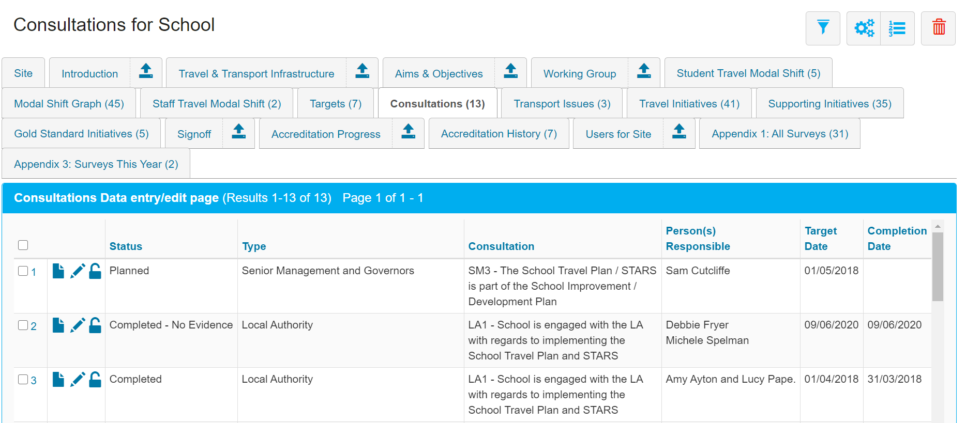
Consultations
xxxxxxxxxxx
xxxxxxxxxxxxxxxxxxxxxxxxxxxxxxx
xxxxxxxxxxxxxxxx
Notes:
Consultations ensure that those who should be are involved in the school travel plan. Some schools have gained bronze in the past and the SMT have not been involved – needs to be owned by the school. Consultations are required with these groups – pupils/parents/staff/senior management team/governors/residents/business/local community/local authority. 2 consultation initiatives for green/bronze, 7 for silver and 10 for gold/Platinum. Can be any combination of consultations.
Add an initiative now: LA – attended STARS training provided by HCC Travel Planning Team.
Examples of consultations:
Pupils – in depth pupil survey. Parents – in depth parent survey. Staff – travel plan discussed at staff meetings. SMT and governors – travel plan discussed at meetings and recorded. Residents/businesses/local community – residents informed of school’s efforts to promote safe and active travel. LA – school engages with travel planning team.

Slide 29


Recording Transport Issues
Use the pencil icon to add a new issue
Notes:
To add a transport issue in your vicinity, open up the ‘Transport Issue’ tab at the top of the page and click on the pencil icon.
To record the issue – Select the appropriate status (new, current, resolved); categorise it and note the date it became and issue.
Then report on how it was tackled and ultimately resolved if it has been, upload evidence, and click resolve button if appropriate. (not all issues can be resolved)

Slide 30


Adding new actions (Initiatives)
xxxxxxxxxxxx
xxxxxxxxxxxxxxxxxxxxxxxxxxxxxxxxxxxxxxxxx
xxxxx
xxxxxxxxxxxxxx
xxxxxxxxxxxxxx
Notes:
Adding a new action (initiative – travel or supporting) – Initiatives Guide and highlighter pen to hand!
Use the cogs and choose “add new action”
Status – planned (not yet completed) or completed (if added retrospectively)Expired if over 3 years old
Type - Select appropriate section (air quality, curriculum etc) – note that Gold Standard and Funding initiatives can wait until a later stage. We hope to receive an updated initiatives guide from Modeshift in due course which will include these but not needed until you are nearly at Gold!
Action – once you have selected the section you wish to add from, the available initiatives will load into this list. Select the one you wish to add. There are “other” codes in each section e.g. W16/17/18 in Walking and Scooting so you can tailor the initiative to what you have done if it is in addition to the regular choices.
Action title/details should be a quick summary of what you have planned
Person responsible is the lead member of staff for this activity
Target and completion dates need to be filled in accurately. You can go back three years if entering information in hindsight but the initiatives won’t count after this time.
Please add the number of pupils and staff involved – it doesn’t always have to be whole school but could be a class or group of pupils taking part in an initiative
Complete reporting information once you have completed the initiative – explain about the activity, what happened / level of engagement and whether the pupils enjoyed the activity
THEN CLICK SAVE! Sometimes the system has a funny five minutes and if you haven’t saved at this point you may lose your work ☹
You can then go back into the initiative and upload evidence if you have it. To do this, complete the description of what evidence you are uploading (risk assessment, evidence of planning, photos (backs of heads only is advisable), posters created by pupils etc) and use the “browse” button to find your file on your computer. Select the file and it will upload to the system.

Slide 31

Expired Initiatives/Consultations
Notes:
Travel/supporting initiatives and consultations have to be renewed after 3 years. The system now indicates when an initiative is out of date - it states that it has expired. There are separate tabs showing expired travel/supporting initiatives and consultations.

Slide 32

Accreditation Progress
Notes:
This provides an overview as to where you are towards completing your STARS level.
All will be highlighted in green if you’ve completed a particular level and a submit button will appear for you to submit your plan. You MUST let us know if you are ready to submit an award i.e. if everything has gone green at a particular level. Just drop us an email and we will check it through for you and let you know that we have put it through to Modeshift or if there are any issues which we can then work through together. We put accreditations through termly so don’t panic if you miss the end of term deadline.

Slide 33

Sign Off
Notes:
‘Sign off’ is included as part of the ‘accreditation progress’ tab.
The travel plan MUST be signed off by the senior management team, usually the Head Teacher, as a minimum and all other members of the working group (can be signed on their behalf). This means that you agree that the evidence you have uploaded can be viewed externally i.e. photos of children MUST have permissions.
Completing and saving ‘sign-off’ will submit your school’s travel plan for accreditation.
The SMT are required to provide a statement of endorsement. Example Statement from Red Barn: Over the last three years we have noticed the impact the stars award has had on the reduction of traffic; children are better prepared with awareness of road safety whilst walking, cycling and 'scootering'. They are able to talk about how to keep themselves safe, such as wearing helmets and wearing appropriate clothing. The children are also aware of the dangers of air pollution to the environment and how travelling in alternative ways can lessen the risk.
The Modeshift award has had a positive impact on the children and staff at Red Barn School. Thank you!

Slide 34
Generate School Travel Plan
Click here to generate a PDF of the school’s travel plan
Notes:
Go to the cogs. Select “Generate School Travel Plan”.
This will create a pdf for you to print off / save onto your school website / share with your parent community.

Slide 35

Walking Bubble Map
Notes:
As schools returned in September 2020 #StaySafeGetActive was launched to assist families on their journeys to school.
Through STARS you can create a Walking Bubble Map for your school. In the ‘Guidance Tab’ in the black bar at the top of the page there is a guidance note on how to do this. The idea of the Walking Bubbles is to create voluntary car-free zones around schools, encouraging everyone who can to ‘Get Active’ on their journeys to and from school. The Bubbles will also encourage families that have to travel by car to park at least 5-minute away from school, creating a safer space for walking, cycling and scooting. By placing these restrictions it is hoped to reduce the number of cars parked on pavements outside and close to the school gates, which as you will know is one of the main concerns that parents have when walking to school. Reducing vehicles and creating more space will also make it much easier for families to socially distance and feel safer around school gates.
To create a walking bubble map go to the cogs and click on Generate Walking Bubble map.

Slide 36

Planning Application
Notes:
If your school has submitted or is planning to submit a planning application for expansion you can enter details about it in this section, site plans, note changes to the site and possible changes to opening hours etc.

Slide 37
Keep it current!
Modeshift STARS
Thank you for coming and we look forward to signing off your awards soon ☺
Notes:
It’s important that you keep updating your travel plan with what you do each year, especially as you have a changing school population.
Hands up survey needs to be completed annually to keep it valid.
Each initiative needs a piece of supporting evidence for it to count beyond Bronze level accreditation.
Discuss with SMT how everyone in the school community is going to contribute to the school travel plan.
OFSTED will not award outstanding if your school doesn’t achieve the children activity levels required – your travel plan can help towards this.

