Slide 1

Welcome to the Active Travel Ambassador (ATA)
Programme!

Slide 2
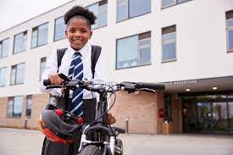
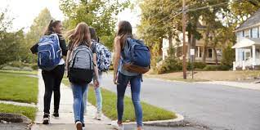



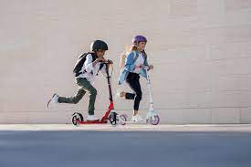

What is Active Travel and why is it important?
Improves physical health.
Improves mental wellbeing.
Helps the local environment.
Helps us to socialise with friends and family.
Notes:
Active travel = making journeys in a physically active way such as walking, cycling, scooting, running or wheeling (using a wheelchair or a mobility aid).
Children and young people aged 5-18 should aim for an average of at least 60 minutes of physical activity a day.
Benefits:
- Regular exercise can reduce the risk of major health conditions such as Type 2 diabetes, cardiovascular disease and heart disease. It also improves your immune system.
Boosts your mental health and reduces the risk of depression, anxiety levels and fatigue. Improves concentration and sleep. Releases endorphins which improves our mood.
Reduces congestion and air pollution.

Slide 3

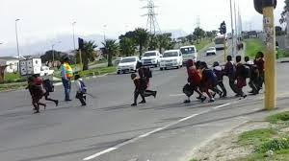
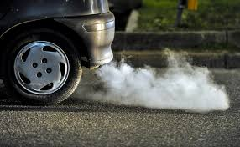

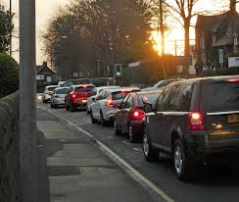

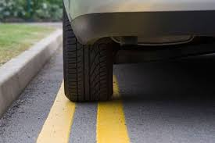
Are there issues outside your school?
Notes:
Issues could include traffic congestion, air pollution, dangerous parking.
Active Travel reduces transport emissions and air pollution outside the school gates, improving air quality.

Slide 4

YOU can make a difference by taking action and becoming an Active Travel Ambassador!
Notes:
The ATA scheme gives pupils the opportunity to tackle travel issues in their school community and promote safe, sustainable travel.
Ambassadors will research and develop their own event or campaign, focussed on active travel and road safety.

Slide 5

Active Travel Ambassadors will develop their own behaviour change campaign, focusing on Active Travel and Road Safety..
Responsible Travel
Personal Safety
Road
Safety
Active
Travel
Notes:
Campaign ideas could focus on:
- Active Travel: Increase the number of students walking or cycling to school.
Road Safety: Improve pupils’ knowledge and behaviour when travelling.
Responsible Travel: Ensure students act in a responsible way when travelling to improve relations with other users of public transport and the wider local community
Personal Safety: Ensuring pupils feel safe and secure when travelling.

Slide 6



Being an ATA is your chance to learn new skills:
CREATE YOUR OWN CAMPAIGN AND HAVE FUN!!
Work together as a team.
Gain confidence and make a difference.
Gain experience for UCAS/Job applications.
Have your voice heard!
Notes:
Ambassadors will learn new skills to pass on to their peers and leave a legacy in their school community:
Gain project management skills
Gain confidence and make a difference
Work together as a team

Slide 7

To get involved, speak to ………
THANK YOU!
Notes:
[Insert name of ATA Staff Member]

