Slide 1


Welcome to the Active Travel Ambassador (ATA) programme!
You have been selected to make up an elite team of students to complete a mission. Your mission is to make the journey to your school a happier, healthier and safer one…
Notes:
Active Travel Ambassador (ATA) is a programme that aims to tackle travel related issues affecting secondary school students.
As a group of ATAs, you are tasked to run a campaign or event that aims to address issues at your school linked to road safety, personal safety, active travel and community relationships.

Slide 2





As a group of Ambassadors, you will identify an existing travel issue at your school and think of a solution to the problem..
Session 1:
Learn about the benefits of active travel.
Undertake research to identify barriers to active travel at your school.
Session 2:
Think about what action you would like to take and create an Action Plan to tackle the problem.
Session 3:
Develop public speaking and presentation skills.
Present your ideas to the school community!
Being an ATA is your chance to:
Session 4:
Project Evaluation
Work as a team! Build confidence! Learn new skills! Have the opportunity to be heard!

Slide 3
Session objectives
By the end of todays session, you will:
Understand how and why people make travel choices.
2. Understand and be able to describe the benefits of active travel.
3. Undertake research to identify the current travel habits and active travel barriers at your school.
Notes:
By becoming an ATA you can bring about positive change to your peers and school community, as well as develop your own skills, knowledge and experience linked to project management.
ATA is linked to the National STARS School Travel Awards, part of the Modeshift STARS scheme. If your school is registered to Modeshift STARS, your work as part of the ATA programme will contribute to a level of national accreditation.

Slide 4
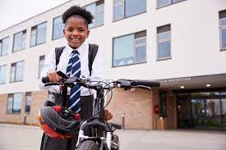
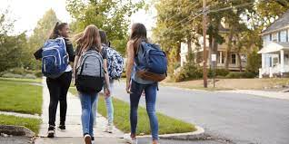



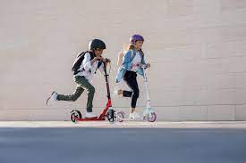

What is Active Travel and why is it important?
Improves physical health.
Improves mental wellbeing.
Helps the local environment.
Helps us to socialise with friends and family.
Notes:
Active travel = making journeys in a physically active way such as walking, cycling, scooting, running or wheeling (using a wheelchair or a mobility aid).
Children and young people aged 5-18 should aim for an average of at least 60 minutes of physical activity a day.
Benefits:
- Regular exercise can reduce the risk of major health conditions such as Type 2 diabetes, cardiovascular disease and heart disease. It also improves your immune system.
Boosts your mental health and reduces the risk of depression, anxiety levels and fatigue. Improves concentration and sleep. Releases endorphins which improves our mood.
Reduces congestion and air pollution.

Slide 5


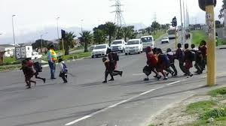
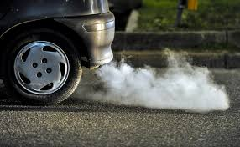

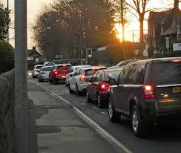

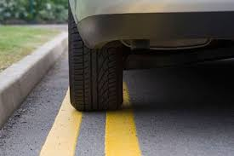

Are there issues outside your school?
Notes:
Issues could include traffic congestion, air pollution, dangerous parking.
Active Travel reduces transport emissions and air pollution outside the school gates, improving air quality.

Slide 6
Why don’t more people walk and cycle to school?
Choose the top three BARRIERS for students in YOUR school
Be ready to explain them to the class!
Distance
Safety
Cost
Energy
Laziness
Parents
Weather
Time
Notes:
Partner Work and feedback/discussion: Ask students to work in pairs. They are to discuss and decide on the top three barriers for students in their school regarding walking and cycling to school. Ask for volunteers to feedback their thoughts. Ensure they explain their thinking behind their choices.

Slide 7






Active Travel Benefits:
ENVIRONMENT | HEALTH | SOCIAL
Notes:
Class Discussion: Ask students to consider the benefits of active travel in terms of social benefits, the environment and our health. Asking for volunteers, feedback their thoughts. As a class you can record ideas on a whiteboard/ flipchart under the appropriate headings.
Note: Health can include physical and psychological factors.
Interesting facts/ information on air quality:
The best ways to reduce air pollution are by walking and riding a bicycle.
If everyone walked one day a week instead of driving, traffic would be reduced by at least 10%.
Poor air quality causes 40,000 early deaths in the UK every single year.
Air pollution can cause asthma, heart disease and even lung cancer.

Slide 8
Active Travel Benefits:
IT GETS YOU OUTDOORS
IT REDUCES AIR POLLUTION
IT IMPROVES ACADEMIC PERFORMANCE
REDUCES CONGESTION
One in four cars in morning traffic are on the school run!
IT CAN SAVE YOU TIME
IT PROVIDES DAILY EXERCISE
Active travel counts towards your recommended 60 minutes of daily exercise
Notes:
Air Pollution: Poor air quality is bad for our health and the environment.
Concentration: Studies have found there is a positive correlation between academic performance and physical activity. Physical activity improves concentration.
Daily Exercise: Travelling actively incorporates physical activity into the daily routine.
Time efficient: Avoids traffic jams.

Slide 9
Your task is to think of a solution to a travel issue at your school! To do this, you will need to undertake some research…

Slide 10




Research Methods
Interviews
Observation
Complete a site audit of the school grounds using the Site Audit Template.
Surveys
Explore how your school thinks and feels about travel to school using the Travel Issue Interview Template.
Complete a Hands up Survey via the Modeshift STARS System.
Notes:
Surveys, Observation and Interviews are examples of research methods available for pupils to use to gather data on barriers to active travel at their school.
Hands-up Survey can by completed by a school staff member via the Modeshift STARS website.
Using the templates provided, ask the Ambassadors to complete ‘Travel Issue Interviews’ and a ‘Site Audit’ to gather data on barriers to active travel at their school.

Slide 11
Next Session…
In the next session, you will use your research findings to decide a campaign idea to tackle the travel issue at your school!

