Slide 1


Planning and Promoting your Campaign
Active Travel Ambassadors Programme.

Slide 2

Session objectives
1. As a team, decide upon one issue to focus your campaign on and have decided upon a solution.
2. Identify practical and realistic initiatives that will form part of the campaign.
3. Create an Action Plan and develop a Monitoring Framework.
4. Learn about the importance of promoting your campaign.

Slide 3
Task
Using all the data you have collected so far, work as a team to answer the following questions:
What is the most important travel issue?
What is the least popular mode of transport?
What would encourage people to change their travel behaviour?
What are the current active travel facilities like at your school?

Slide 4






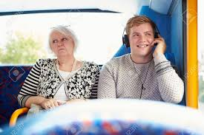

Choosing the focus - What is the problem?
Discuss and reach a decision on what behaviour you would like to increase:
Discuss and reach a decision on what behaviour you want to decrease:
Notes:
Increase: Walking, Cycling, Park & Stride, Active Travel, Road Safety Awareness, improve behaviour on Public Transport?
Decrease: Congestion, Lateness, poor behaviour on Public Transport?

Slide 5



Choosing the focus - Who are you going to target? And why?
Discuss and reach a decision on who your campaign will target:
Whole School Community
Students
Staff

Slide 6
Campaign Ideas
Active Travel Assembly?
Road Safety Awareness Assembly?
Promote a walk to school day?
Active Travel Competition?
Promote a cycle to school day?
Car free day?
Anti-idling campaign?
Cycle club?

Slide 7
Choosing the right solution!
 | High Impact | Medium Impact | Low Impact
Easy Work | Ideal |  | e.g. put up posters
Medium Work |  | e.g. deliver an assembly
Hard Work | e.g. run a social media campaign |  | Avoid
Notes:
Use the Impact vs Work matrix as a visual tool to explain why certain campaign ideas are not suitable. Print or draw matrix on whiteboard. Refer to it when new campaign ideas arise.

Slide 8
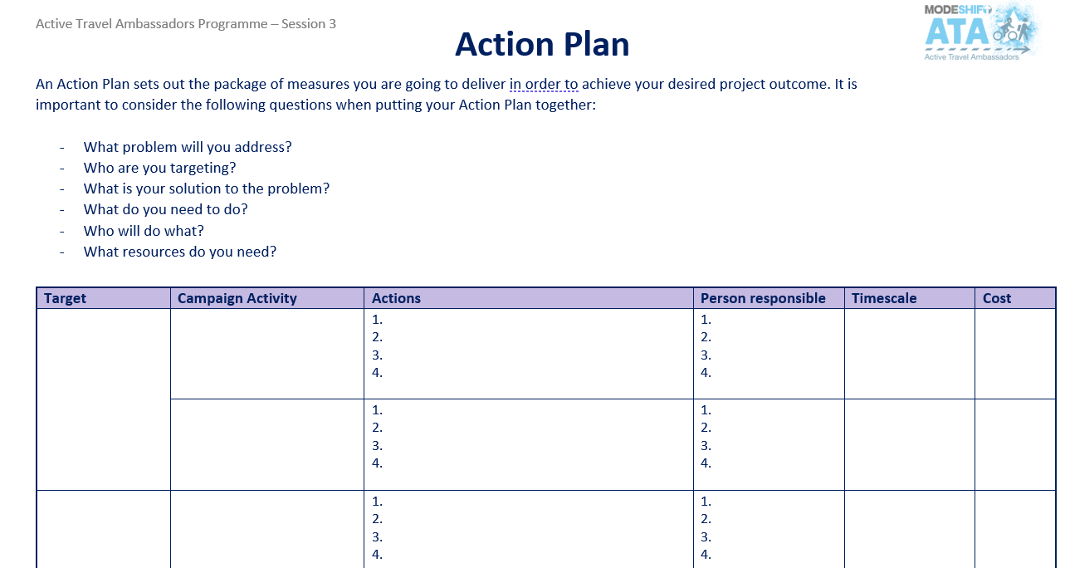
Action Plan - As a group, complete the Action Plan document
.
Notes:
Step-by-step actions needed for campaign activity. Encourage pupils to consider the timeline of campaign. Keep the Action Plan and Monitoring Framework simple.

Slide 9
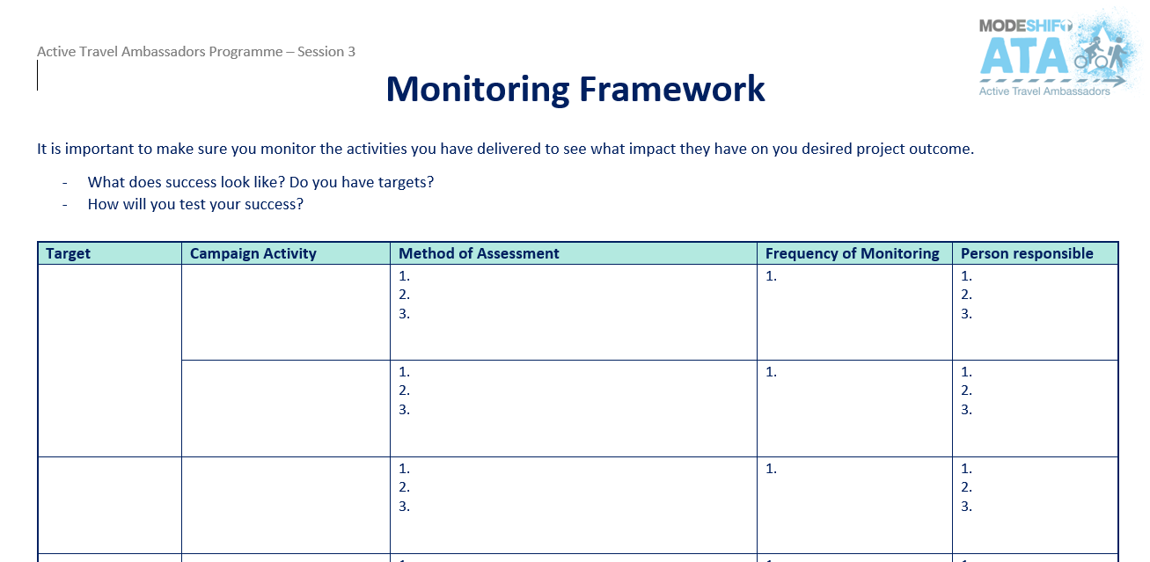
Monitoring Framework
You will need to monitor the impact of all of the actions that you plan on delivering to see if they have achieved a change in behaviour.
Complete the Monitoring Framework document to help you keep on track throughout your campaign:

Slide 10
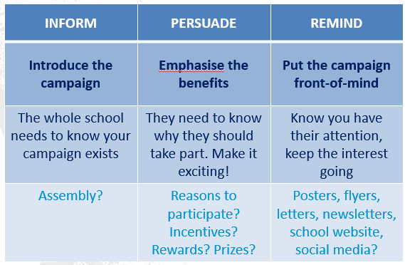
Promoting your campaign
Effective promotion will follow the below three stages
Notes:
Explain the importance of promotion
Inform people about your campaign.
Persuade people that they want to be part of it.
Remind people about it regularly – keep them interested!

Slide 11










Marketing your campaign and creating a brand!
Developing a brand will help people recognise your campaign and can help them understand what you are trying to achieve:
Logo
Slogan
Images
Fonts
Colour
Be sure to promote your campaign to the whole school!!
Notes:
Ask the ATAs what they know about marketing.
Emphasise the importance of marketing and promoting the campaign to the whole school before it is launched! Need to get as many pupils on board as possible.

Slide 12
Homework..
Design and produce any campaign materials that you need in order to promote your campaign. These can include posters, film, literature etc.

Slide 13
Next Session…
In the next session, you will learn important presentation techniques to promote your campaign idea to the school community!

