Slide 1


Presentation Skills
Active Travel Ambassadors Programme.

Slide 2

Session objectives
1. Understand the process of presenting.
2. Learn skills and strategies for effective presenting and have practiced techniques to give an engaging presentation.
3. Be prepared to deliver your pitch to a group of peers, school staff, the Senior Leadership Team or during an assembly!

Slide 3


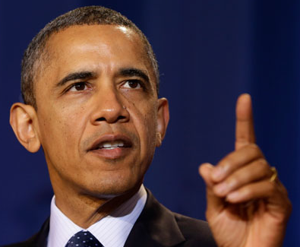
What are the qualities of a good presenter or public speaker?
Voice…
Body language…
Other qualities…
Personality…
Notes:
Students discuss in pairs/ small groups filling in table on worksheet (shown on next slide). Ask class for feedback filling in answers on a group flip chart/whiteboard. Students can note down any other qualities they think of.

Slide 4
Qualities of a good presenter
Body language | Voice | Others

Slide 5





The
Power Position
Stepping out
Create a Role play
State your key message when in the power position
Using the Space
Helps your audience focus on the speaker
Brings your presentation to
life!
Notes:
Use the physical space on stage to map out the structure of your presentation!

Slide 6
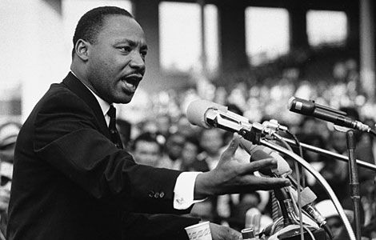
Pausing and Emphasising
Why is pausing effective?
Why is emphasizing effective?
Pausing between the phrases gives the listener time to understand and process the information.
It draws listeners in, brings the text to life and makes the most important information stand out.
Both help make your speech more
engaging, entertaining and fun
to listen to!
Notes:
Click on image of Martin Luther King Jr for link to YouTube video. Ask students how Martin Luther King delivered his speech – when did he pause and which words did he emphasise?

Slide 7




The 4 ‘P’s of Presenting
Positive thinking
Preparation
Practice
Performance
Notes:
Dealing with nervousness: If students are worried about this you could practice diaphragmatic breathing (‘belly breathing’) with them, eliciting the benefits: It slows your heart rate, provides oxygen to your brain, creates the sound of authority.

Slide 8

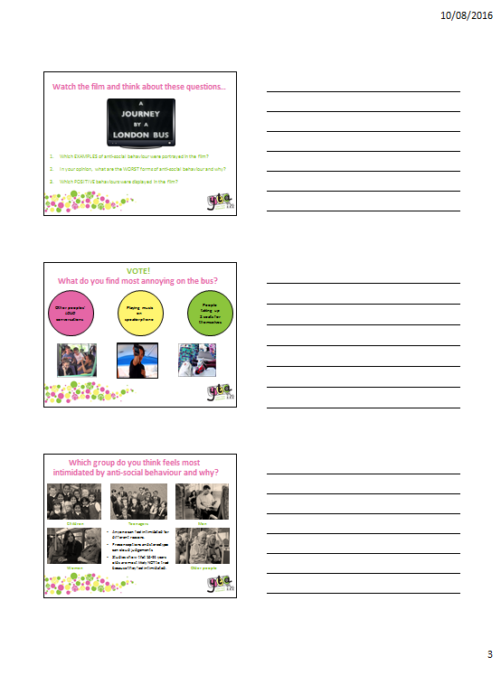
Get ready to present!
Consider the questions below and work as a team to create a presentation for your campaign idea:
What is the problem?
Campaign Questions:
Who are you going to target?
What is your solution?
How will you measure your success?
Print out of slides
Have fun presenting!
Prompt cards
Hands up for…
Correct answer is…
This is because…
Decide who will present each slide and what you will say.
Annotate your print out or make prompt cards to remind you of what to say.
Practise presenting to each other without using the script.
Notes:
Plenary: What were some of the techniques we learnt today? How can pausing and emphasizing improve your presentation? What are the 4 ‘P’s? What are the qualities of a good presenter?
Your audience want to see you SUCCEED and will enjoy taking part!

Slide 9


Next Steps…Take Action!
You are now ready to present and launch your campaign to your school.
Get started on delivering your tasks and don’t forget to record your results - ask for help if you need it!
Collect evidence along the way to make a Poster Report or write an article for your school Newsletter!
Notes:
Poster Report to include – Objective, Key Achievements, Quotes, Photographs, number of pupils involved etc.
Share the success of your campaign with us on Twitter - @TeamModeshift

