Slide 1


Project Evaluation
Active Travel Ambassadors Programme.

Slide 2



ATA Presentation Review
Well done for delivering your ATA presentation!
What have you learnt from this experience?
What went well?
Who has really stood out in your team and why?
What could be improved upon?
ATA - Condensed Version
Notes:
Ask the Ambassadors to reflect on their presentation/ assembly.

Slide 3


Measuring the impact of your campaign..
Why do you think reporting on your ATA campaign is important?
Who are you reporting to and why?
What kind of things do you think you need to report on?
How could you present your report?

Slide 4

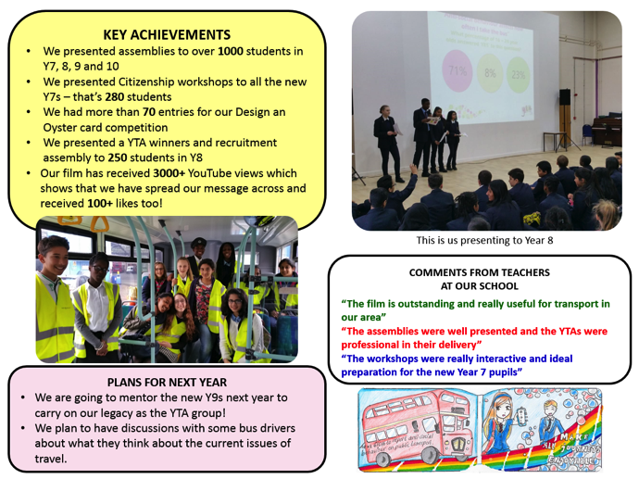
Task
Working in a team or in sub-groups, create a Poster Report or a written report to let people know what you did, why you did it and what you have achieved.
If you are working in your sub-groups, remember to come together as a team and compile your report.
You can use the Poster Report Template or create your own.
Remember to make your Poster Report colourful and interesting!

Slide 5
Poster Report - Example
OUR OBJECTIVE
What did you decide to tackle and why?
What goal did your project set out to achieve and why?
KEY ACHIEVEMENTS AND EVIDENCE
How many people travelled more actively/sustainably?
How many people did you present to?
How many people participated?
FUTURE PLANS
Will any of your project activities continue?
How could you improve your campaign if you did it again?
Is there another travel issue that needs your attention?
PHOTO HIGHLIGHTS
Insert photos that showcase your ATA work
QUOTES, MEDIA, PRESS
Include quotes from teachers and students about a change your campaign has made or is making!
COMPETITION ENTRIES
Insert pictures of any posters

Slide 6



Next steps..
Your journey doesn’t have to stop here.
You can carry on your amazing work as a team and keep pushing to make positive changes to your friends, peers and teachers travel to your school.

