Slide 1


Let’s find out about Clean Air
myjourneyhampshire.com/cleanair
Notes:
Welcome to our Clean Air presentation. Today we’d like to tell you about how important clean air is and ways we can all help to stop our air becoming dirty.

Slide 2


Why is clean air so important?
Breathing clean air keeps our bodies healthy. Clean Air keeps the planet healthy too, plants and animals need clean air to live happy, healthy lives.
Notes:
Health
Fresh, clean air increases the amount of oxygen in your body which helps to strengthen the immune system to fight off bacteria and illness more effectively.
Other benefits to health:
Cleaner lungs.
Decreased asthma and allergies symptoms.
Better mood and normalized sleep patterns.
Reduce chances of lung and heart diseases.
Environment
Cleaner air helps to keep Earth’s temperature stable- pollution traps heat causing the temperature to rise. Cleaner air also keeps Earth’s water cleaner. A stable temperature and clean water are very important for all kinds of plants and animals.

Slide 3


What happens if the air is dirty?
If we breathe dirty air, it can make us cough,
dizzy and unwell.
Dirty air also contributes to global warming. Plants and animals cannot adapt fast enough to keep up with changing temperatures.
Notes:
If we breathe dirty air it can make us cough, dizzy and unwell. It doesn't smell good either and when the air is really polluted we can sometimes see the it in the air. We call this smog.
Global warming is the long-term heating of Earth's climate due to human activities, such as burning fossil fuels like oil and coal. Burning these fuels increases air pollution which traps heat in the Earth's atmosphere. Our animals and plants have adapted to their homes over hundred's of thousands of years. We can all help to slow down global warming by polluting less.

Slide 4
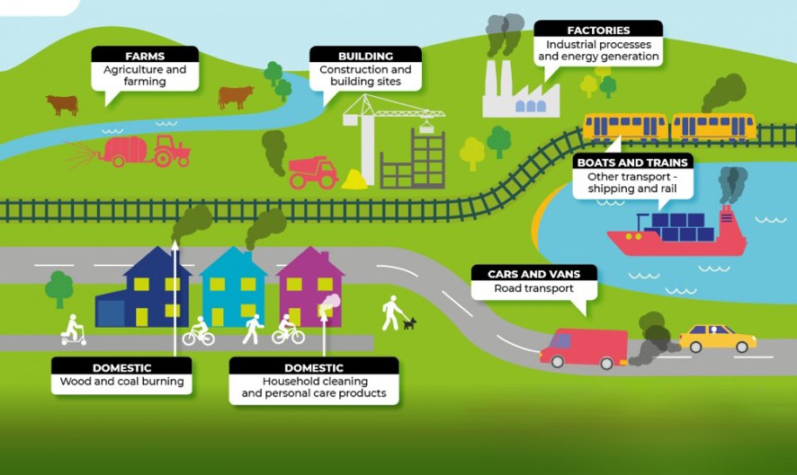
What makes the air dirty?
There are lots of ways the air becomes dirty, but there are lots of ways to make it clean again too!
Notes:
There are lots of ways the air becomes dirty, and it is usually caused by smoke or other harmful gases.
Some sources are:
Farms,
Building sites
Factories
Transport
Wood and coal fires
Cleaning products.

Slide 5
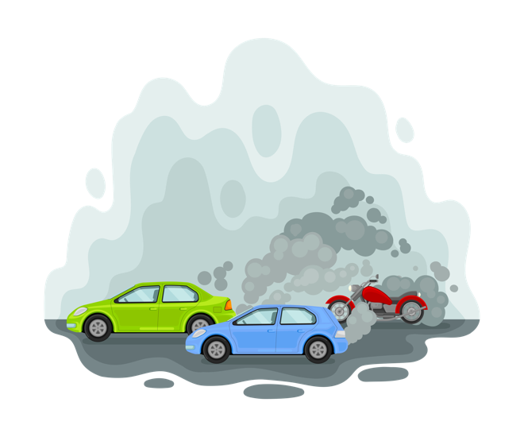
Let’s talk about cars!
One of the biggest sources of air pollution in our towns and cities is from cars!
Did you know… People inside cars breathe more pollution than people who are outside.
Did you know…
There are over 39 million cars in the United Kingdom!
Notes:
Cars produce pollution when they burn fuel. It comes out of the exhaust pipe at the back of the car. While it is likely we all need to use a car sometimes, it is important to think: “Do I really need the car for this journey?”
Explaining “Did you know People inside cars breathe more pollution than people who are outside”…
Imagine a cloud of polluted air. When we are outside that polluted air has lots of space to spread out, it gets blown by the wind, it can float down to the ground or up into the sky. When we are inside a car there’s much less space and nowhere for the pollution to go, it gets trapped inside the car and the people inside are much more likely to breathe dirty air.

Slide 6

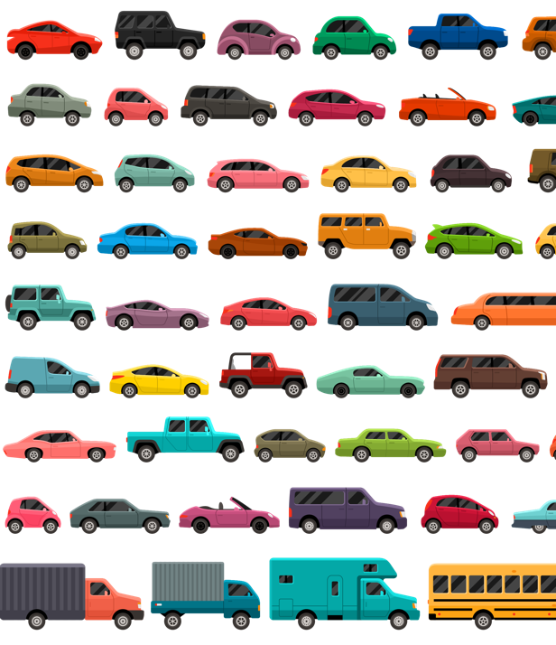

You might be thinking, “How can I make a difference? There’s only one of me and that’s a lot of polluting cars!”
What can I do?
Notes:
You might be thinking, “How can I make a difference? There’s only one of me and that’s a lot of polluting cars!”

Slide 7

You’re not fighting air pollution alone!
v
Look left and right. Look at all the people in this room around you.
Now imagine the hundreds of other schools just like yours, where children are learning about Clean Air.
If we all work together and take small steps towards a big goal, we can keep our air clean!
We can do it together!
Notes:
Look left and right. Look at all the people in this room around you.
Now imagine the hundreds of other schools just like yours, where children are learning about Clean Air.
If we all work together and take small steps towards a big goal, we can keep our air clean!
We can do it together!

Slide 8

What small step will you take?
Listen to the following options.
Will you be able to take any of the steps to help make the air cleaner?
Notes:
Listen to the following options.
Will you be able to take any of the steps to help make the air cleaner?
You may not be able to do every option, but, if we can all try to do at least one we can work together to keep our air clean!

Slide 9
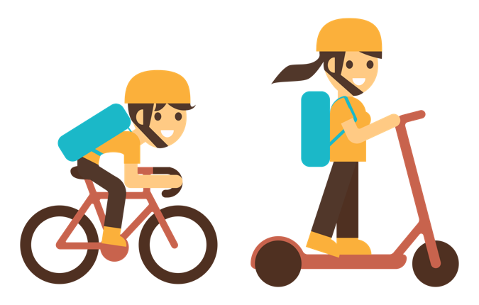

1. Leave the car at home.
Think before you drive, “Can this journey be made in a different way?”
Could you walk, scoot or cycle instead?
Notes:
Walking, scooting and cycling are great ways to travel that do not cause air pollution.
Travelling this way is also fun, good for spending time in nature and great for the health of our minds and bodies.

Slide 10
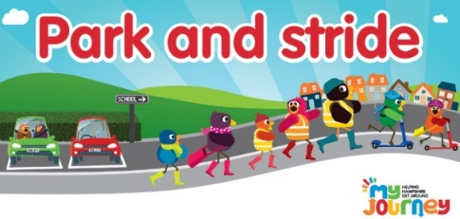
2. Park and Stride
When you have to drive, make your journey shorter and avoid busy, polluting traffic by parking away from your destination and walking or scooting the last part of the journey.
Notes:
Sometimes we all need to use the car. But choosing to Park and Stride is an easy way to reduce the amount of air pollution produced by our cars.
When you have to drive, make your journey shorter and avoid busy, polluting traffic by parking away from your destination and walking or scooting the last part of the journey.

Slide 11

3. Switch off the engine.
Remind car drivers to switch off their engines when stopped. Car idling produces up to 150 balloons of exhaust emissions per minute. Every minute counts!
Notes:
Put your hands up if you have seen a car parked up with it's engine still running? We call this 'idling'. Car idling produces up to 150 balloons of exhaust emissions per minute. Every minute counts! Especially when the car is parked outside your school.
Remind car drivers to switch off their engines when parked. If you know you are going to be waiting in the car, where appropriate clothes for the weather so you don't need to rely on the cars heating. If it's a hot day why not get out of the car and find a shady spot outside to wait. Or, if you know you are going to arrive early park further away from school and walk the last part of the journey.

Slide 12

4. Help nature to help us!
Give nature a helping hand and do some gardening! Trees absorb pollution from the air making it cleaner for us to breathe. Planting hedges and climbing plants like ivy against fences creates a barrier that traps air pollution from nearby roads.
Notes:
Through the process of photosynthesis, trees absorb carbon dioxide from our atmosphere and reduce the 'greenhouse effect' (the warming of the Earth's surface and atmosphere) creating a less polluted, more sustainable world for future generations.
Trees are most effective at absorbing carbon dioxide because they are big and live a long time, but all plants photosynthesise. You may not be able to plant a tree but even a houseplant in a pot will do its bit to help clean the air inside your home.
Planting hedges and climbing plants like ivy against fences creates a barrier that traps air pollution from nearby roads.

Slide 13

5. Spread the word
Tell your friends and family about how important it is to keep the air clean and the ways that they can help. The more people that know about clean air the more people we will have helping us to fight air pollution!
Notes:
Now you know so much more about keeping our air clean, spread he word! The more people who know how to help the better.

Slide 14

You can be a Clean Air champion!
myjourneyhampshire.com/cleanair
Notes:
Thank you for listening so well to the Clean Air presentation. I hope it has taught you about the importance of keeping our air clean and giving you some ideas of how you can do your bit!
Put your hand up if you would like to be a clean air champion?
Who is going to try to leave the car at home more often?
Who is going to try and park and stride more often?
Who is going to remind drivers to switch off their engines?
Who is going to try and help nature by planting trees and plants?
Who is going to spread the word?
Fantastic! You really are clean air champions!

