Slide 1
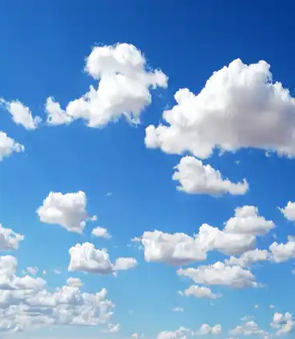

Clean Air
myjourneyhampshire.com/cleanair
Notes:
Welcome to our Clean Air presentation. Today we’d like to tell you about how important clean air is and ways we can all help to stop our air becoming dirty.

Slide 2
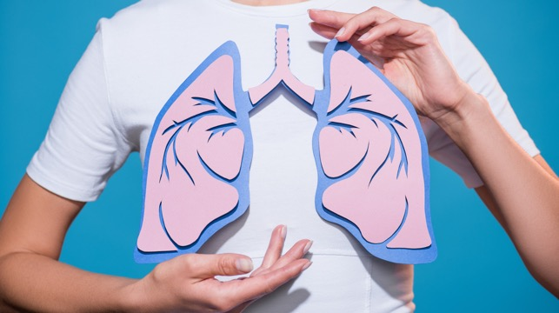

What is air pollution?
  Air pollution is a mixture of particles
  and gases.
  The main air pollutants of concern
  nationally are:
      particulate matter (PM), and
      nitrogen dioxide (NO₂).
  This type of air pollution is so small that it can’t be seen by the naked eye and can be inhaled deep into the lungs. Once inhaled they can pass directly into the bloodstream.
Notes:
Air pollution is a mixture of particles and gases.
The main air pollutants of concern nationally are:
particulate matter (PM), and
nitrogen dioxide (NO2).
This type of air pollution is so small that it can’t be seen by the naked eye and can be inhaled deep into the lungs. Once inhaled they can pass directly into the bloodstream.

Slide 3
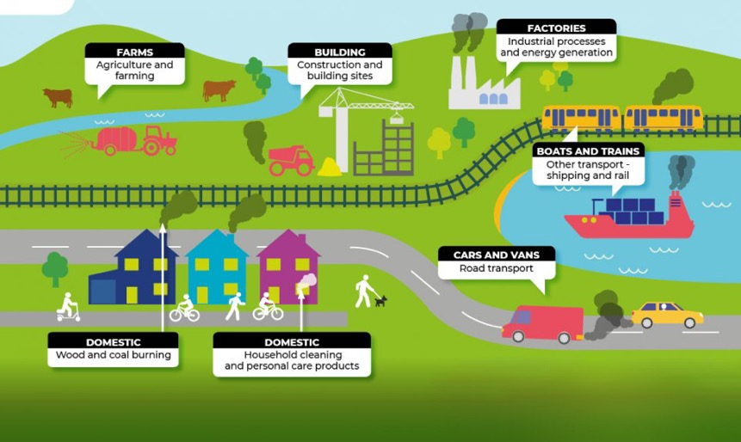
Where does air pollution come from?
Air pollution comes from many sources.
It is important for all of us to identify how we can help reduce air pollution.
Poor air quality contributes towards global warming. Clean air helps to keep Earth’s temperature stable.
Notes:
There are lots of ways the air becomes dirty, and it is usually caused by smoke or other harmful gases.
Some sources are:
Farms,
Building sites
Factories
Transport
Wood and coal fires
Cleaning products.

Slide 4
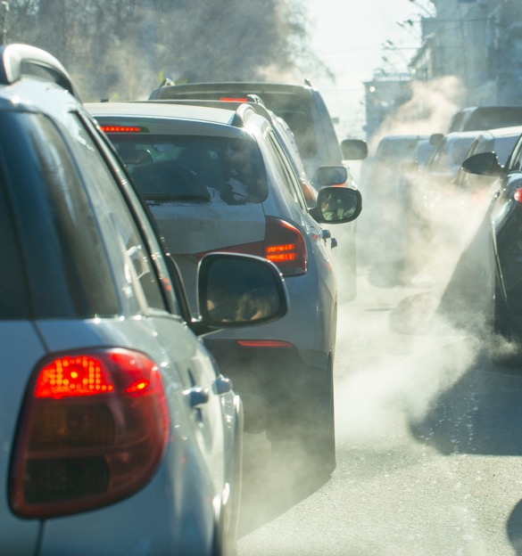
Let’s talk about cars!
One of the biggest sources of air pollution in our towns and cities is from cars!
Did you know…
People inside cars breathe more pollution
than people who are outside.
Did you know...​
There are over 39 million cars in the United
Kingdom!
Notes:
Cars produce pollution when they burn fuel. It comes out of the exhaust pipe at the back of the car. While it is likely we all need to use a car sometimes, it is important to think: “Do I really need the car for this journey?”
Explaining “Did you know People inside cars breathe more pollution than people who are outside”…
Imagine a cloud of polluted air. When we are outside that polluted air has lots of space to spread out, it gets blown by the wind, it can float down to the ground or up into the sky. When we are inside a car there’s much less space and nowhere for the pollution to go, it gets trapped inside the car and the people inside are much more likely to breathe dirty air.

Slide 5
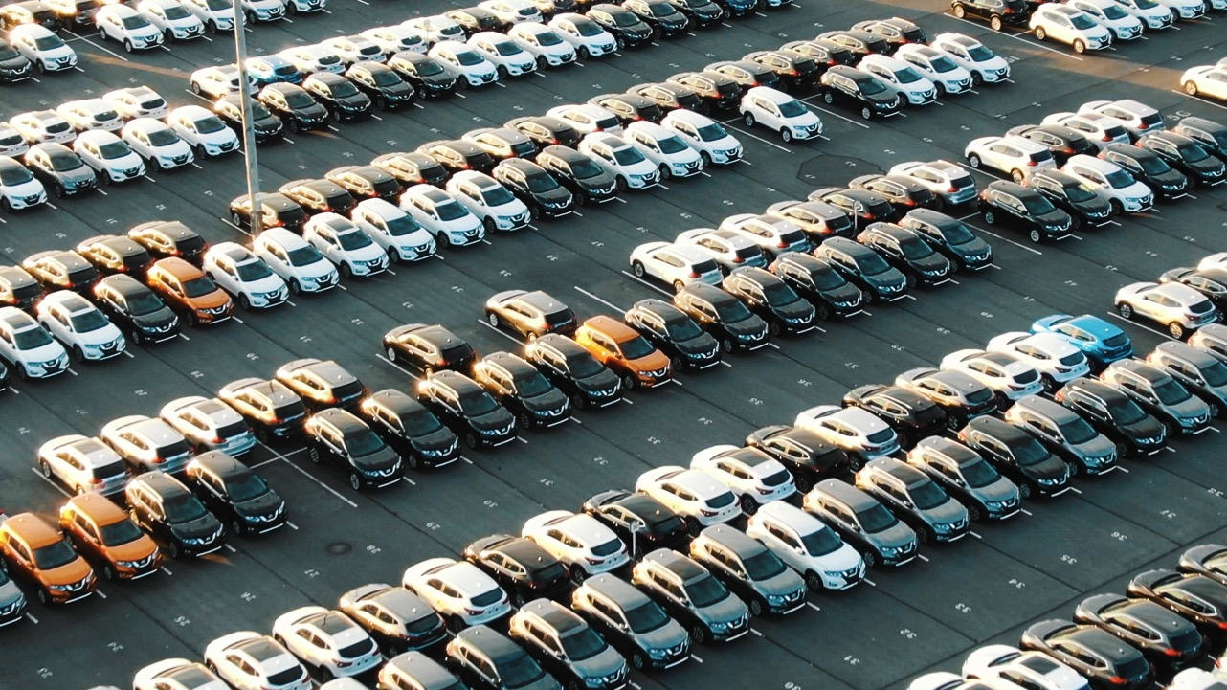

You might be thinking, “How can I make a difference? There’s only one of me and that’s a lot of polluting cars!”
What can I do?
Notes:
You might be thinking, “How can I make a difference? There’s only one of me and that’s a lot of polluting cars!”

Slide 6

You’re not fighting air pollution alone!
v
Look left and right. Look at all the people in this room around you.
Now imagine the hundreds of other schools just like yours, where children
are learning about Clean Air.
If we all work together and take small steps towards a big goal, we can keep
our air clean!
We can do it together!
Notes:
Look left and right. Look at all the people in this room around you.
Now imagine the hundreds of other schools just like yours, where children
are learning about Clean Air.
If we all work together and take small steps towards a big goal, we can keep
our air clean!
We can do it together!

Slide 7
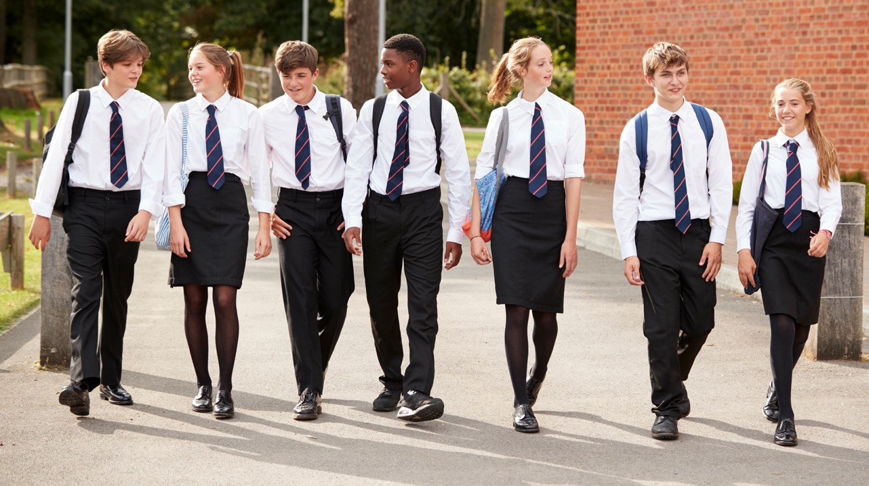
What small step will you take?
Will you be able to take any of the steps to help make the air cleaner?
Notes:
Listen to the following options.
Will you be able to take any of the steps to help make the air cleaner?
You may not be able to do every option, but, if we can all try to do at least one we can work together to keep our air clean!

Slide 8
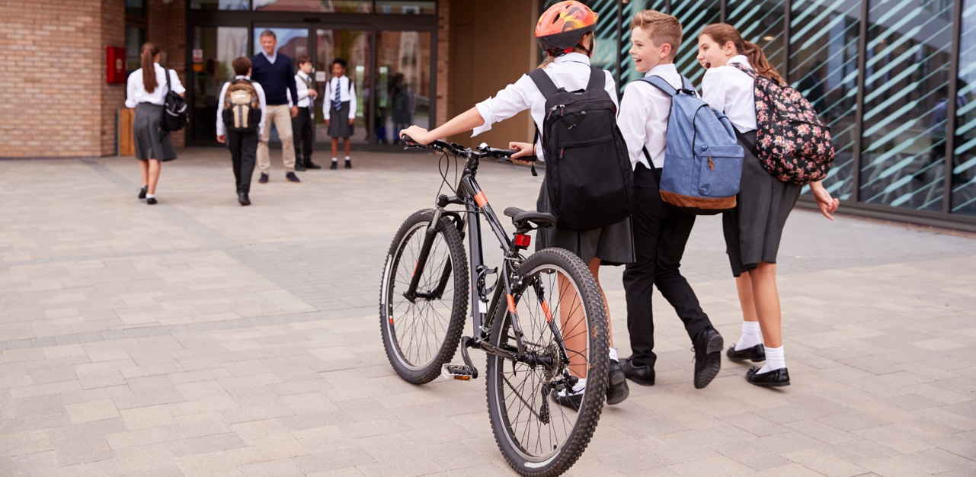
1. Leave the car at home.
Think before you drive, “Can this journey be made in a different way?”
Could you walk, cycle or scoot instead?
Notes:
Walking, scooting and cycling are great ways to travel that do not cause air pollution.
Travelling this way is also fun, good for spending time in nature and great for the health of our minds and bodies.

Slide 9
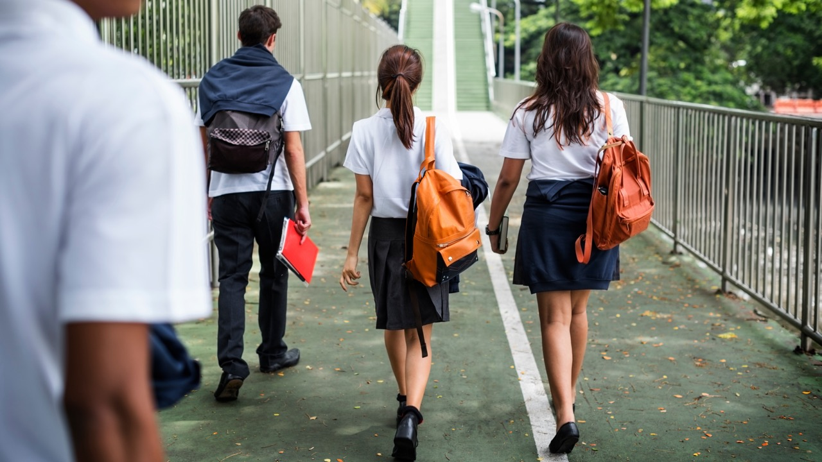
2. Park and Stride
When you have to drive, make your journey shorter and avoid busy, polluting traffic by parking away from your destination and walking or scooting the last part of the journey.
Notes:
Sometimes we all need to use the car. But choosing to Park and Stride is an easy way to reduce the amount of air pollution produced by our cars.
When you have to drive, make your journey shorter and avoid busy, polluting traffic by parking away from your destination and walking or scooting the last part of the journey.

Slide 10


3. Switch off the engine.
Remind car drivers to switch off their engines when stopped. Car idling produces up to 150 balloons of exhaust emissions per minute. Every minute counts!
Notes:
I'm sure you have all seen a stopped car with it's engine still running? We call this 'idling'. Car idling produces up to 150 balloons of exhaust emissions per minute. Every minute counts! Especially when the car is parked outside your school.
Remind car drivers to switch off their engines when parked. If you know you are going to be waiting in the car, where appropriate clothes for the weather so you don't need to rely on the cars heating. If it's a hot day why not get out of the car and find a shady spot outside to wait. Or, if you know you are going to arrive early park further away from school and walk the last part of the journey.

Slide 11
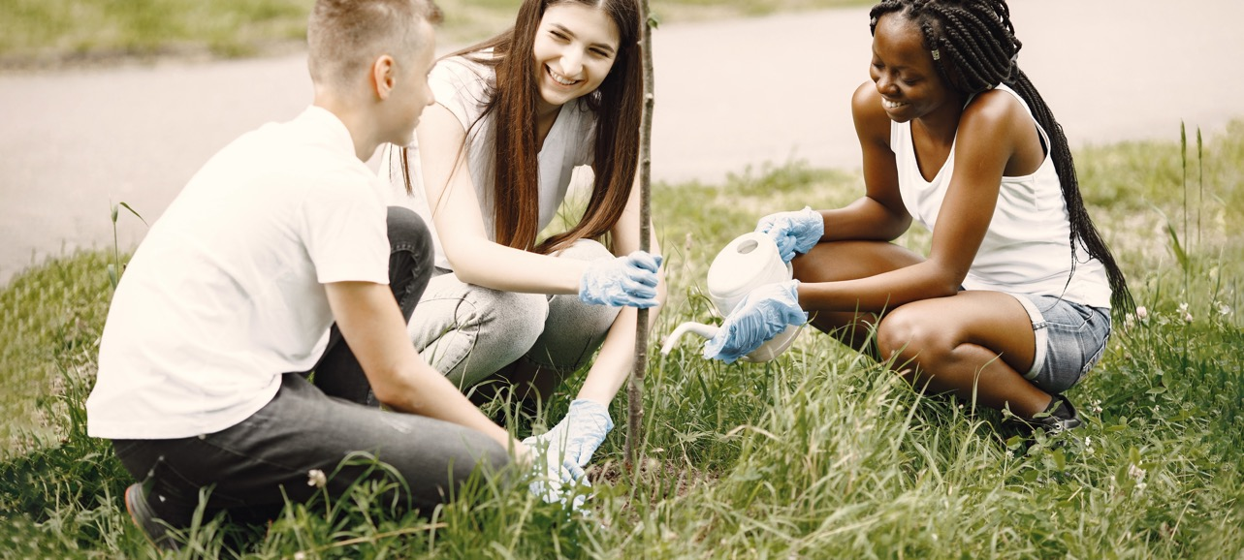
4. Help nature to help us!
Give nature a helping hand and do some gardening!
Trees absorb pollution from the air making it cleaner for us to breathe. Planting hedges and climbing plants like ivy against fences creates a barrier that traps air pollution from nearby roads.
Notes:
Through the process of photosynthesis, trees absorb carbon dioxide from our atmosphere and reduce the 'greenhouse effect' (the warming of the Earth's surface and atmosphere) creating a less polluted, more sustainable world for future generations.
Trees are most effective at absorbing carbon dioxide because they are big and live a long time, but all plants photosynthesise. You may not be able to plant a tree but even a houseplant in a pot will do its bit to help clean the air inside your home.
Planting hedges and climbing plants like ivy against fences creates a barrier that traps air pollution from nearby roads.

Slide 12
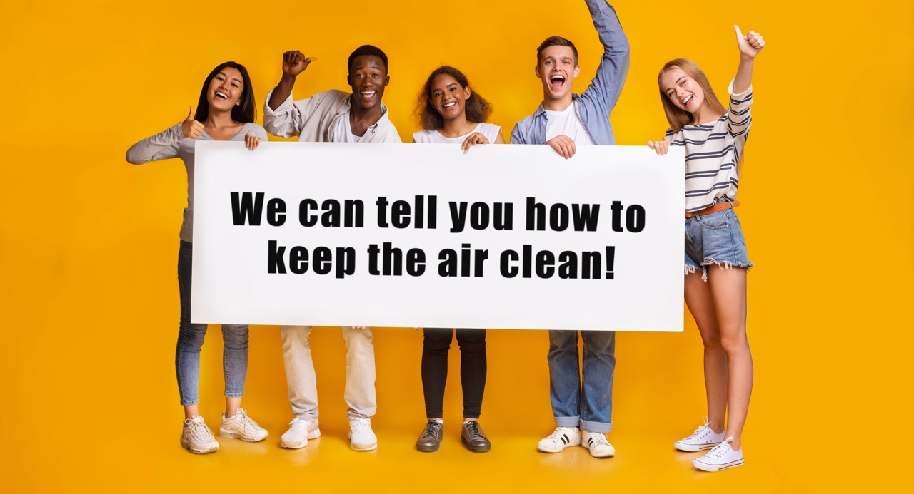
5. Spread the word
Tell your friends and family about how important it is to keep the air clean and the ways that they can help. The more people that know about clean air the more people we will have helping us to fight air pollution!
Notes:
Now you know so much more about keeping our air clean, spread he word! The more people who know how to help the better.

Slide 13




You can be a Clean Air champion!
myjourneyhampshire.com/cleanair
Notes:
Thank you for listening so well to the Clean Air Presentation. I hope it has taught you about the importance of keeping our air clean and giving you some ideas of how you can do your bit!
Put your hand up if you will do your bit to be a clean air champion!
Who is going to try to leave the car at home more often?
Who is going to try and park and stride more often?
Who is going to remind drivers to switch off their engines?
Who is going to try and help nature by planting trees and plants?
Who is going to spread the word?
Fantastic! You really are clean air champions!

