Slide 1
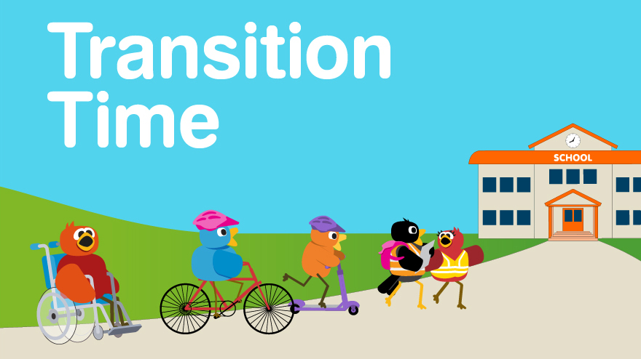

Slide 2
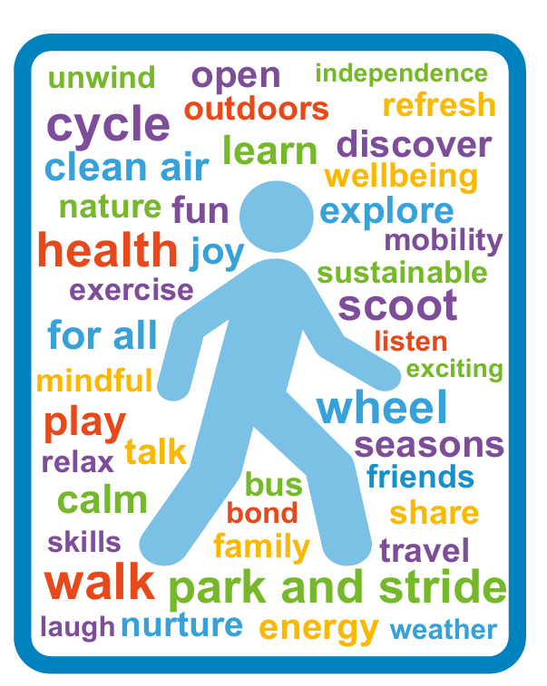



Your journey to our school:
As a school, we encourage all families who are able, to walk, wheel, scoot or cycle to school (active travel). This can be for all, or part of your journey.
Travelling actively has numerous benefits for you and your children’s health and wellbeing. It also benefits our wider community and helps the school’s efforts to promote children’s travel skills, independence and sustainability.
myjourneyhampshire.com/hampshire-transition

Slide 3
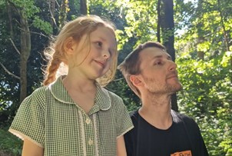
Skylar’s mission to train her Papa:
Skylar set herself the tricky task of training her Papa to walk and ween him off the car. Check out their funny video to see how she got on and some of the many benefits to active travel.
Watch Skylar's video
You can also view it by visiting: myjourneyhampshire.com/hampshire-transition
myjourneyhampshire.com/hampshire-transition

Slide 4






Some of the benefits of active travel:
“Walking means I don’t need to
stress finding a parking space.”
“I feel free when riding my bike to school.”
“….makes me feel happy and connected to nature.”
Healthy bodies
Healthy minds
Skills and independence
Improved air quality
Time for conversation, listening and shared moments
myjourneyhampshire.com/hampshire-transition
Notes:
Children and young people aged 5–18 should get at least 60 minutes of physical activity each day. Walking, wheeling or cycling to school is a simple way to build this into daily routines.
Active travel can improve mood, reduce stress, and help students feel ready for the school day, supporting emotional wellbeing.
Starting the day actively helps boost focus, alertness and learning in the classroom.
Active travel helps reduce levels of pollution, both in terms of carbon emissions and air pollution. (It also helps keep more money in your pocket from savings on fuel!) This helps make our school environment healthier for all.
Walking, wheeling, scooting or cycling also creates valuable time with friends and family, helping to build confidence, independence, lifelong skills and positive connections.

Slide 5

Park and Stride:
We appreciate it is not always possible to travel actively everyday and sometimes a car is needed.
We encourage families to Park and Stride, to allow children to feel the benefits of an active stage in their journey. A 5-10 minute walk from the car to school can have a huge positive impact!
As a school, please insert your possible park and stride locations here, giving journey times and any relevant info, such as time restrictions on parking.
Other options you might like to promote include, 5-minute walking bubble, Scoot from the Boot, park on my drive and lift sharing.
myjourneyhampshire.com/hampshire-transition
Notes:
5-minute walking bubble – A map highlighting areas within a 5-minute walk/wheel of the school, showing suitable and safe on-street parking locations.
Scoot from the Boot - Similar to Park and Stride, but children are encouraged to scoot rather than walk.
Park on my drive – an informal arrangement where parents or carers ask a friend or someone they know who lives closer to the school if they can use their driveway for drop-off and/or pick-up.

Slide 6

Park responsibly:
Parking outside schools can cause:
Health issues from increased air pollution
Road safety risks
Difficulties for local residents
We kindly ask parents and carers not to park:
On the ‘School Keep Clear’ zig zags
Opposite or within 10m (approx. 33 feet) of a junction
Near crossing points to allow those walking and wheeling better visibility
On pavements or verges, unless signposted otherwise
Across driveways and other vehicle access points
At bus stops or designated bus bays
myjourneyhampshire.com/hampshire-transition

Slide 7
How the school will support your child’s travel skills:
Here is a great opportunity to boost parent confidence by showcasing some of the work done in school to support children’s travel skills. This can include information on initiatives that support active travel, such as:
Participation in Walk to School week
Training such as pedestrian skills sessions, Bikeability training, etc
Road safety initiatives, such as Be Bright Be Seen and Road Safety Day
Going on local walks / curriculum walks
Participation in Junior Road Safety Officers
If the school has an accredited travel plan with Modeshift Stars, here is a good time to discuss this and showcase the award
Including photos and children’s quotes from past initiatives here can help
parents engage and picture their own child’s participation.
myjourneyhampshire.com/hampshire-transition

Slide 8

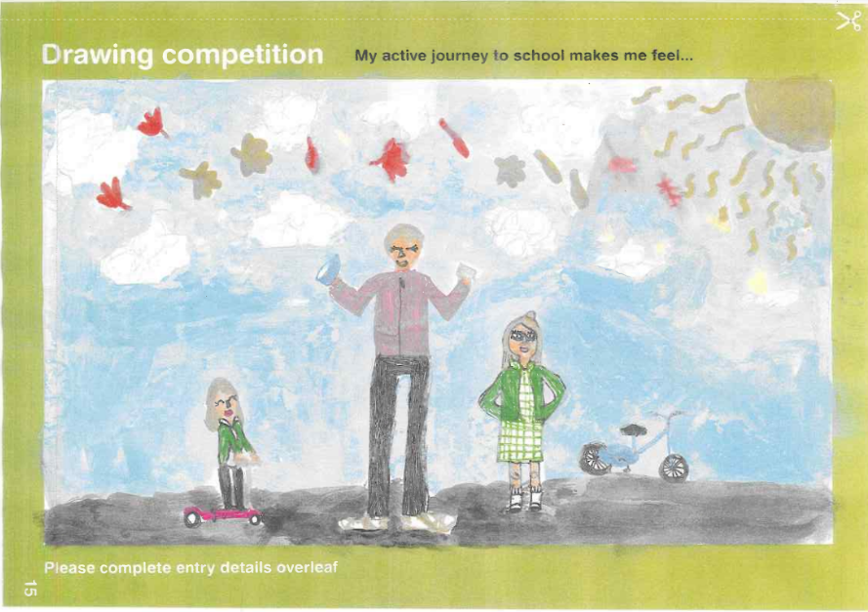
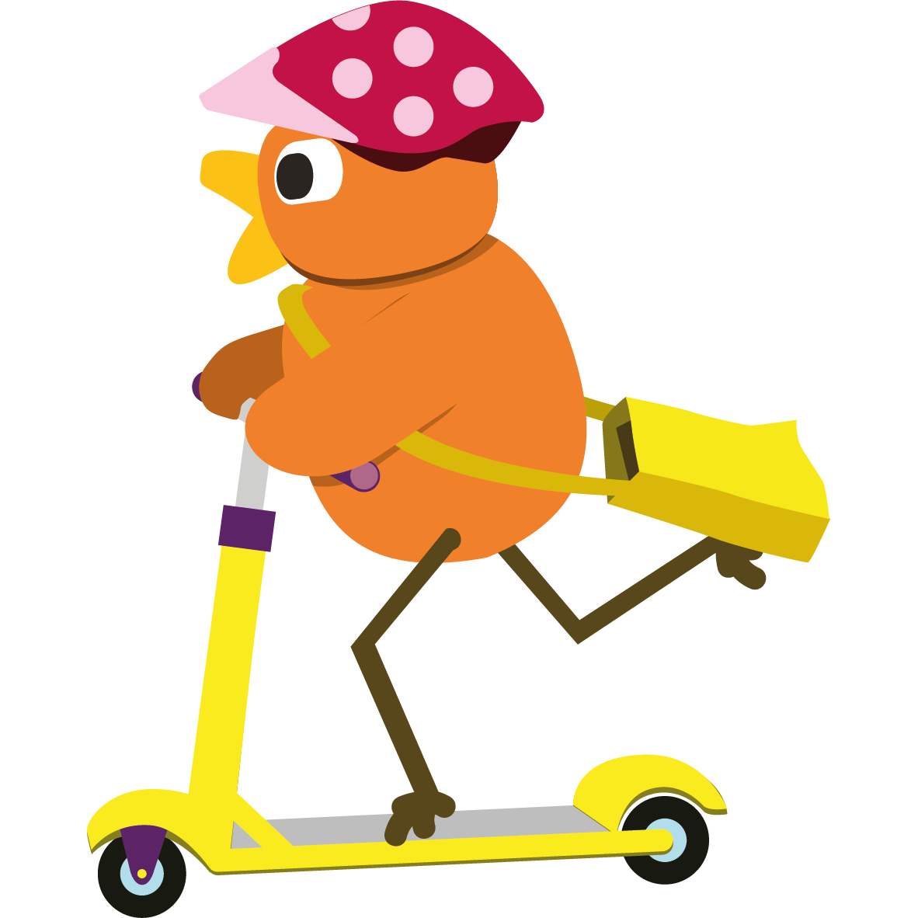
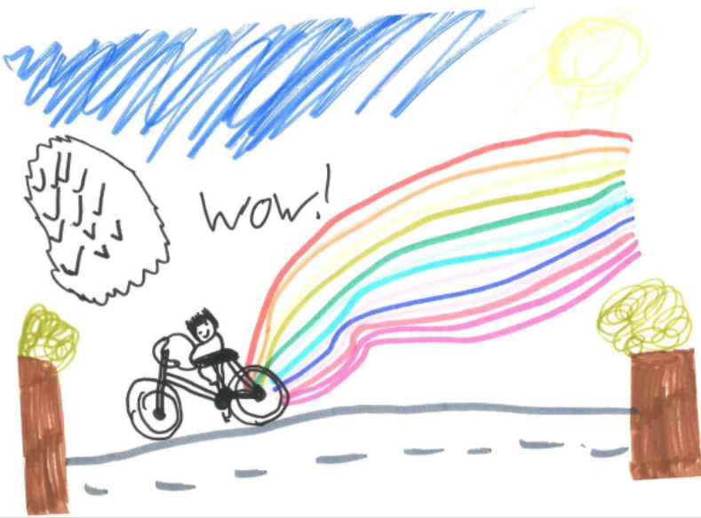
Further support available:
There is further information, guidance and resources available,
exploring active and sustainable travel, on the My Journey Hampshire website.
Parents: myjourneyhampshire.com/parents
Some examples include:
- Guides to support Walk, Talk, Listen on the school journey.
Wellbeing activities
Further information on Transition Time, with information booklets, drawing competitions and much more!
myjourneyhampshire.com/hampshire-transition

Slide 9

We hope you enjoy your new journey

