Slide 1


Slide 2
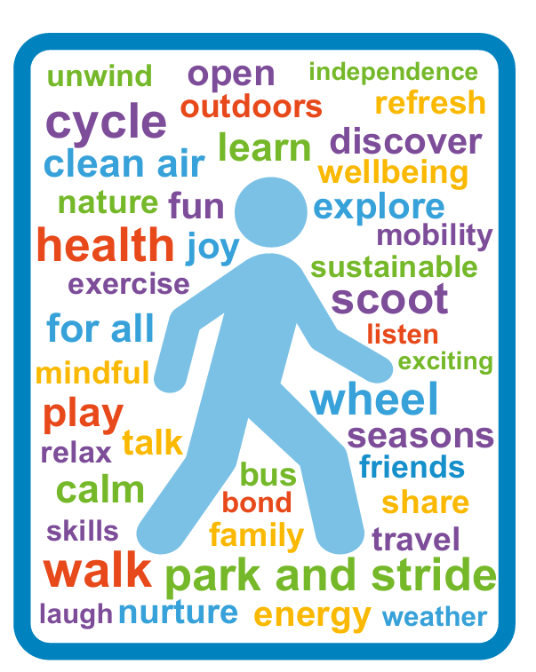



Your journey to our school:
As a school, we encourage all students who are able, to walk, wheel, scoot or cycle to school (active travel). This can be for all, or part of their journey.
Travelling actively has numerous benefits for their health and wellbeing. It also benefits our wider community and helps the school’s efforts to promote young people’s travel skills, independence and sustainability.
myjourneyhampshire.com/hampshire-transition

Slide 3





Some of the benefits of active travel:
“I feel free when riding my bike to school.”
“I enjoy walking to school with my brothers after drop off at the car park.”
“There is less pollution when we do not drive.”
Healthy bodies
Healthy minds
Skills and independence
Improved air quality
Time for conversation
with friends
myjourneyhampshire.com/hampshire-transition
Notes:
Young people aged 5–18 should get at least 60 minutes of physical activity each day. Walking, wheeling or cycling to school is a simple way to build this into daily routines.
Active travel can improve mood, reduce stress, and help students feel ready for the school day, supporting emotional wellbeing.
Starting the day actively helps boost focus, alertness and learning in the classroom.
Active travel helps reduce levels of pollution, both in terms of carbon emissions and air pollution. (It also helps keep more money in your pocket from savings on fuel!) This helps make our school environment healthier for all.
Walking, wheeling, scooting or cycling also creates valuable time with friends, helping to build confidence, independence, lifelong skills and positive connections.

Slide 4

Park and Stride:
We appreciate it is not always possible to travel actively everyday and sometimes a car is needed.
We encourage families to Park and Stride, to allow students to feel the benefits of an active stage in their journey.
A 5-10 minute walk from the car to school can have a huge positive impact!
As a school, please insert your possible park and stride locations here, giving journey times and any relevant info, such as time restrictions on parking.
Other options you might like to promote include, 5-minute walking bubble, being dropped/collected at a more local friends house and lift sharing.
myjourneyhampshire.com/hampshire-transition
Notes:
5-minute walking bubble – A map highlighting areas within a 5-minute walk/wheel of the school, showing suitable and safe on-street parking locations.

Slide 5

Park responsibly:
Parking outside schools can cause:
Health issues from increased air pollution
Road safety risks
Difficulties for local residents
We kindly ask parents and carers not to park:
On the ‘School Keep Clear’ zig zags
Opposite or within 10m (approx. 33 feet) of a junction
Near crossing points to allow those walking and wheeling better visibility
On pavements or verges, unless signposted otherwise
Across driveways and other vehicle access points
At bus stops or designated bus bays
myjourneyhampshire.com/hampshire-transition

Slide 6

Just the Journey Map:
Our school’s Just the Journey map has been developed to assist new Year 7 pupils to plan their new, independent journey to secondary school.
It includes information on walking zones, crossings, public transport links and local travel routes.
Here you could include the link for your school’s Just the Journey map and an image snip of the map itself.
Maps can be found at myjourneyhampshire.com/just-the-journey
You may also want to take the opportunity to tell families about the work the school does to support travel to school such as:
Cycle storage provision
Road safety initiatives
Participation in Active Travel Ambassadors
Taking part in campaigns, including Walktober and Clean Air Day
myjourneyhampshire.com/hampshire-transition

Slide 7
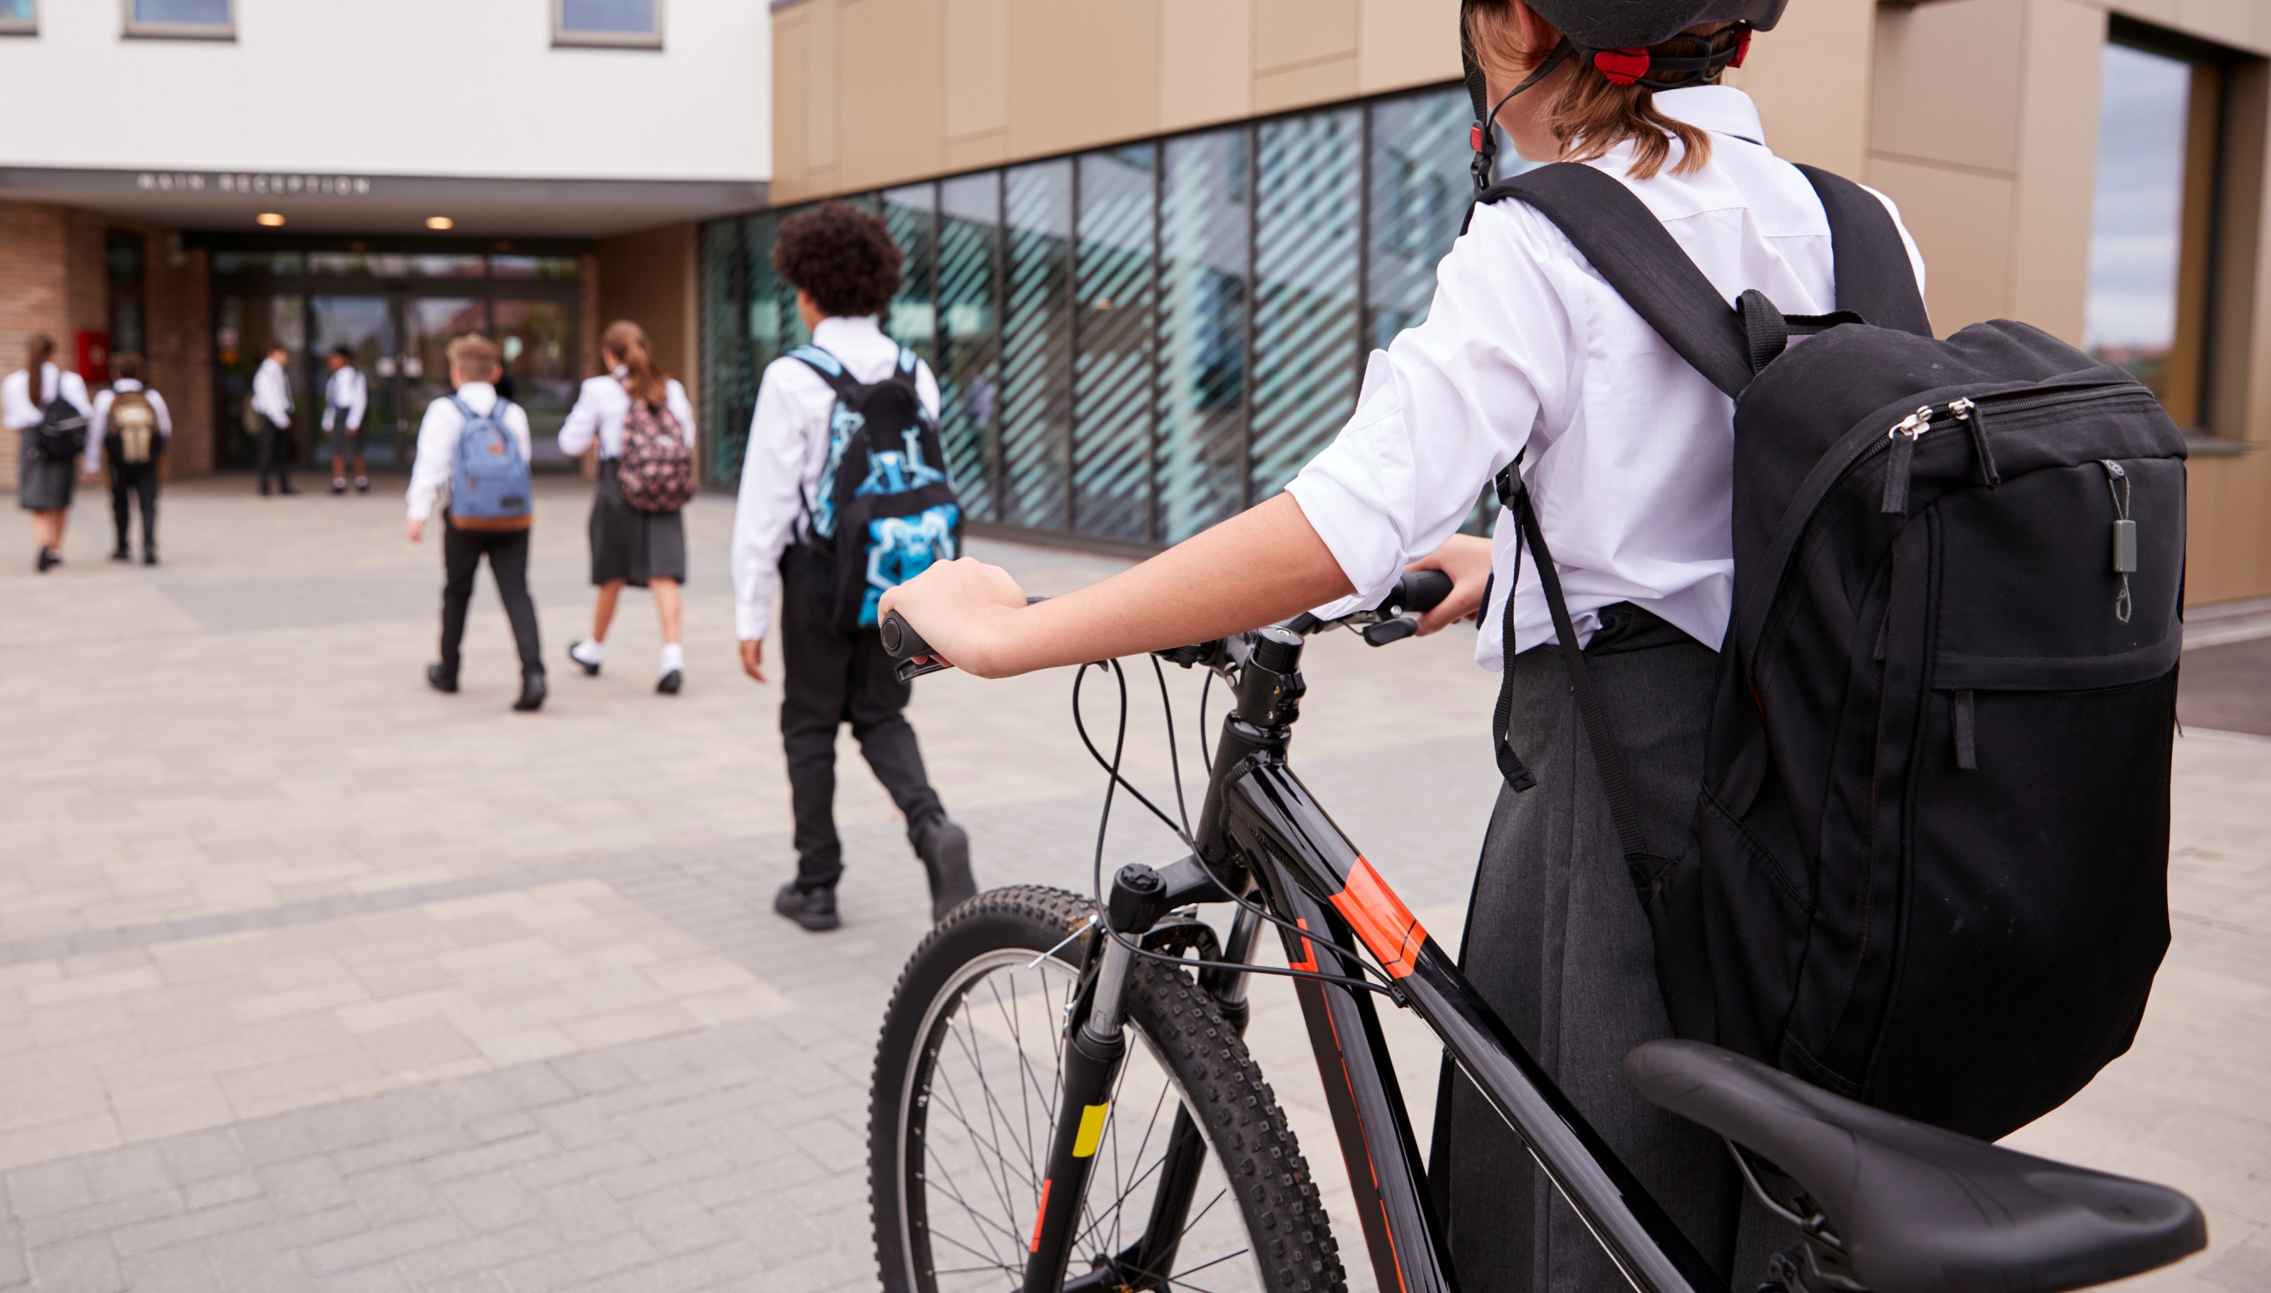
Further support:
There is further information, guidance and resources available,
exploring active and sustainable travel, on the My Journey Hampshire website.
Parents: myjourneyhampshire.com/parents
Some examples include:
Further information on Transition Time, with information leaflets and booklets
The road safety transition newsletter
Cycling skills and bike maintenance videos
myjourneyhampshire.com/hampshire-transition

Slide 8

We hope you enjoy your new journey

