Slide 1
My Top Tips, More Trips report:
Working in Winchester.
I work a combination of home working and working at an office in the centre of Winchester. 🏢
On the days I work in Winchester my journey is:
Drive (often lift sharing with a colleague) to the Park and Ride at St Catherines or Barfields.
I have an option to take the Park and Ride bus – sometimes I do this but always hop off a stop (or two) early, so I get some daily activity. 🚌
However, most days, I walk from the car park - Park and Stride. It takes around 20 minutes maximum, and it is a glorious walk! I usually go into Winchester via Winchester College walls and through Winchester Cathedral grounds. My return route is usually along The Weirs, following the River Itchen. 👟⛪🦆

Slide 2


My Top Tips for an active journey like mine:
Make sure you are prepared for the weather conditions – for example having a hat and water on a hot day and having a waterproof jacket on a wet day. Don’t let the weather stop you taking an active journey!
Take time to observe and enjoy the world around you, whether that’s, like my journey, looking at a building, spotting wildlife, listening to the sound of the river or feeling the sun on your face.
Time – work out how long your walking journey will take and plan in any extra time needed (I would probably spend longer in a car stuck in traffic in Winchester than walking)!

Slide 3
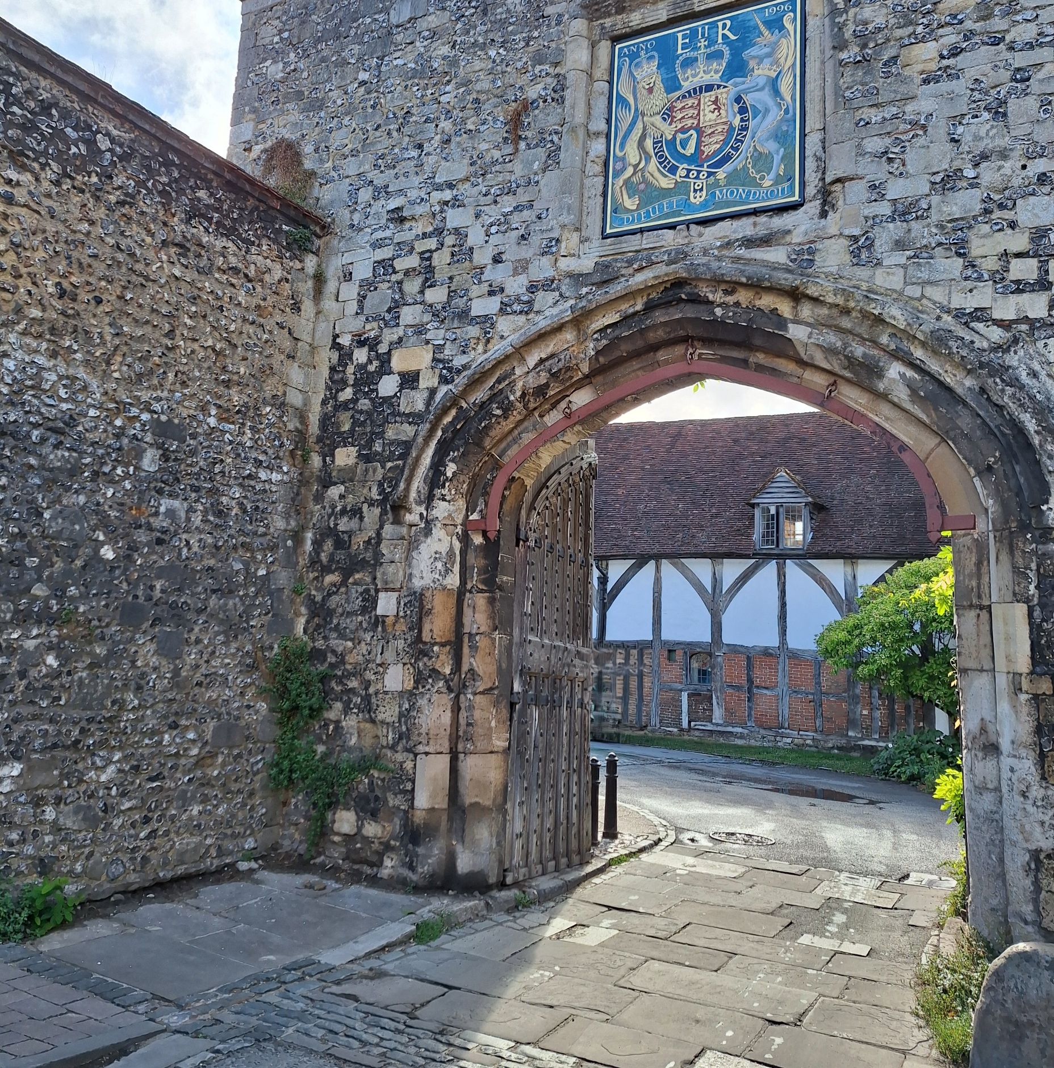
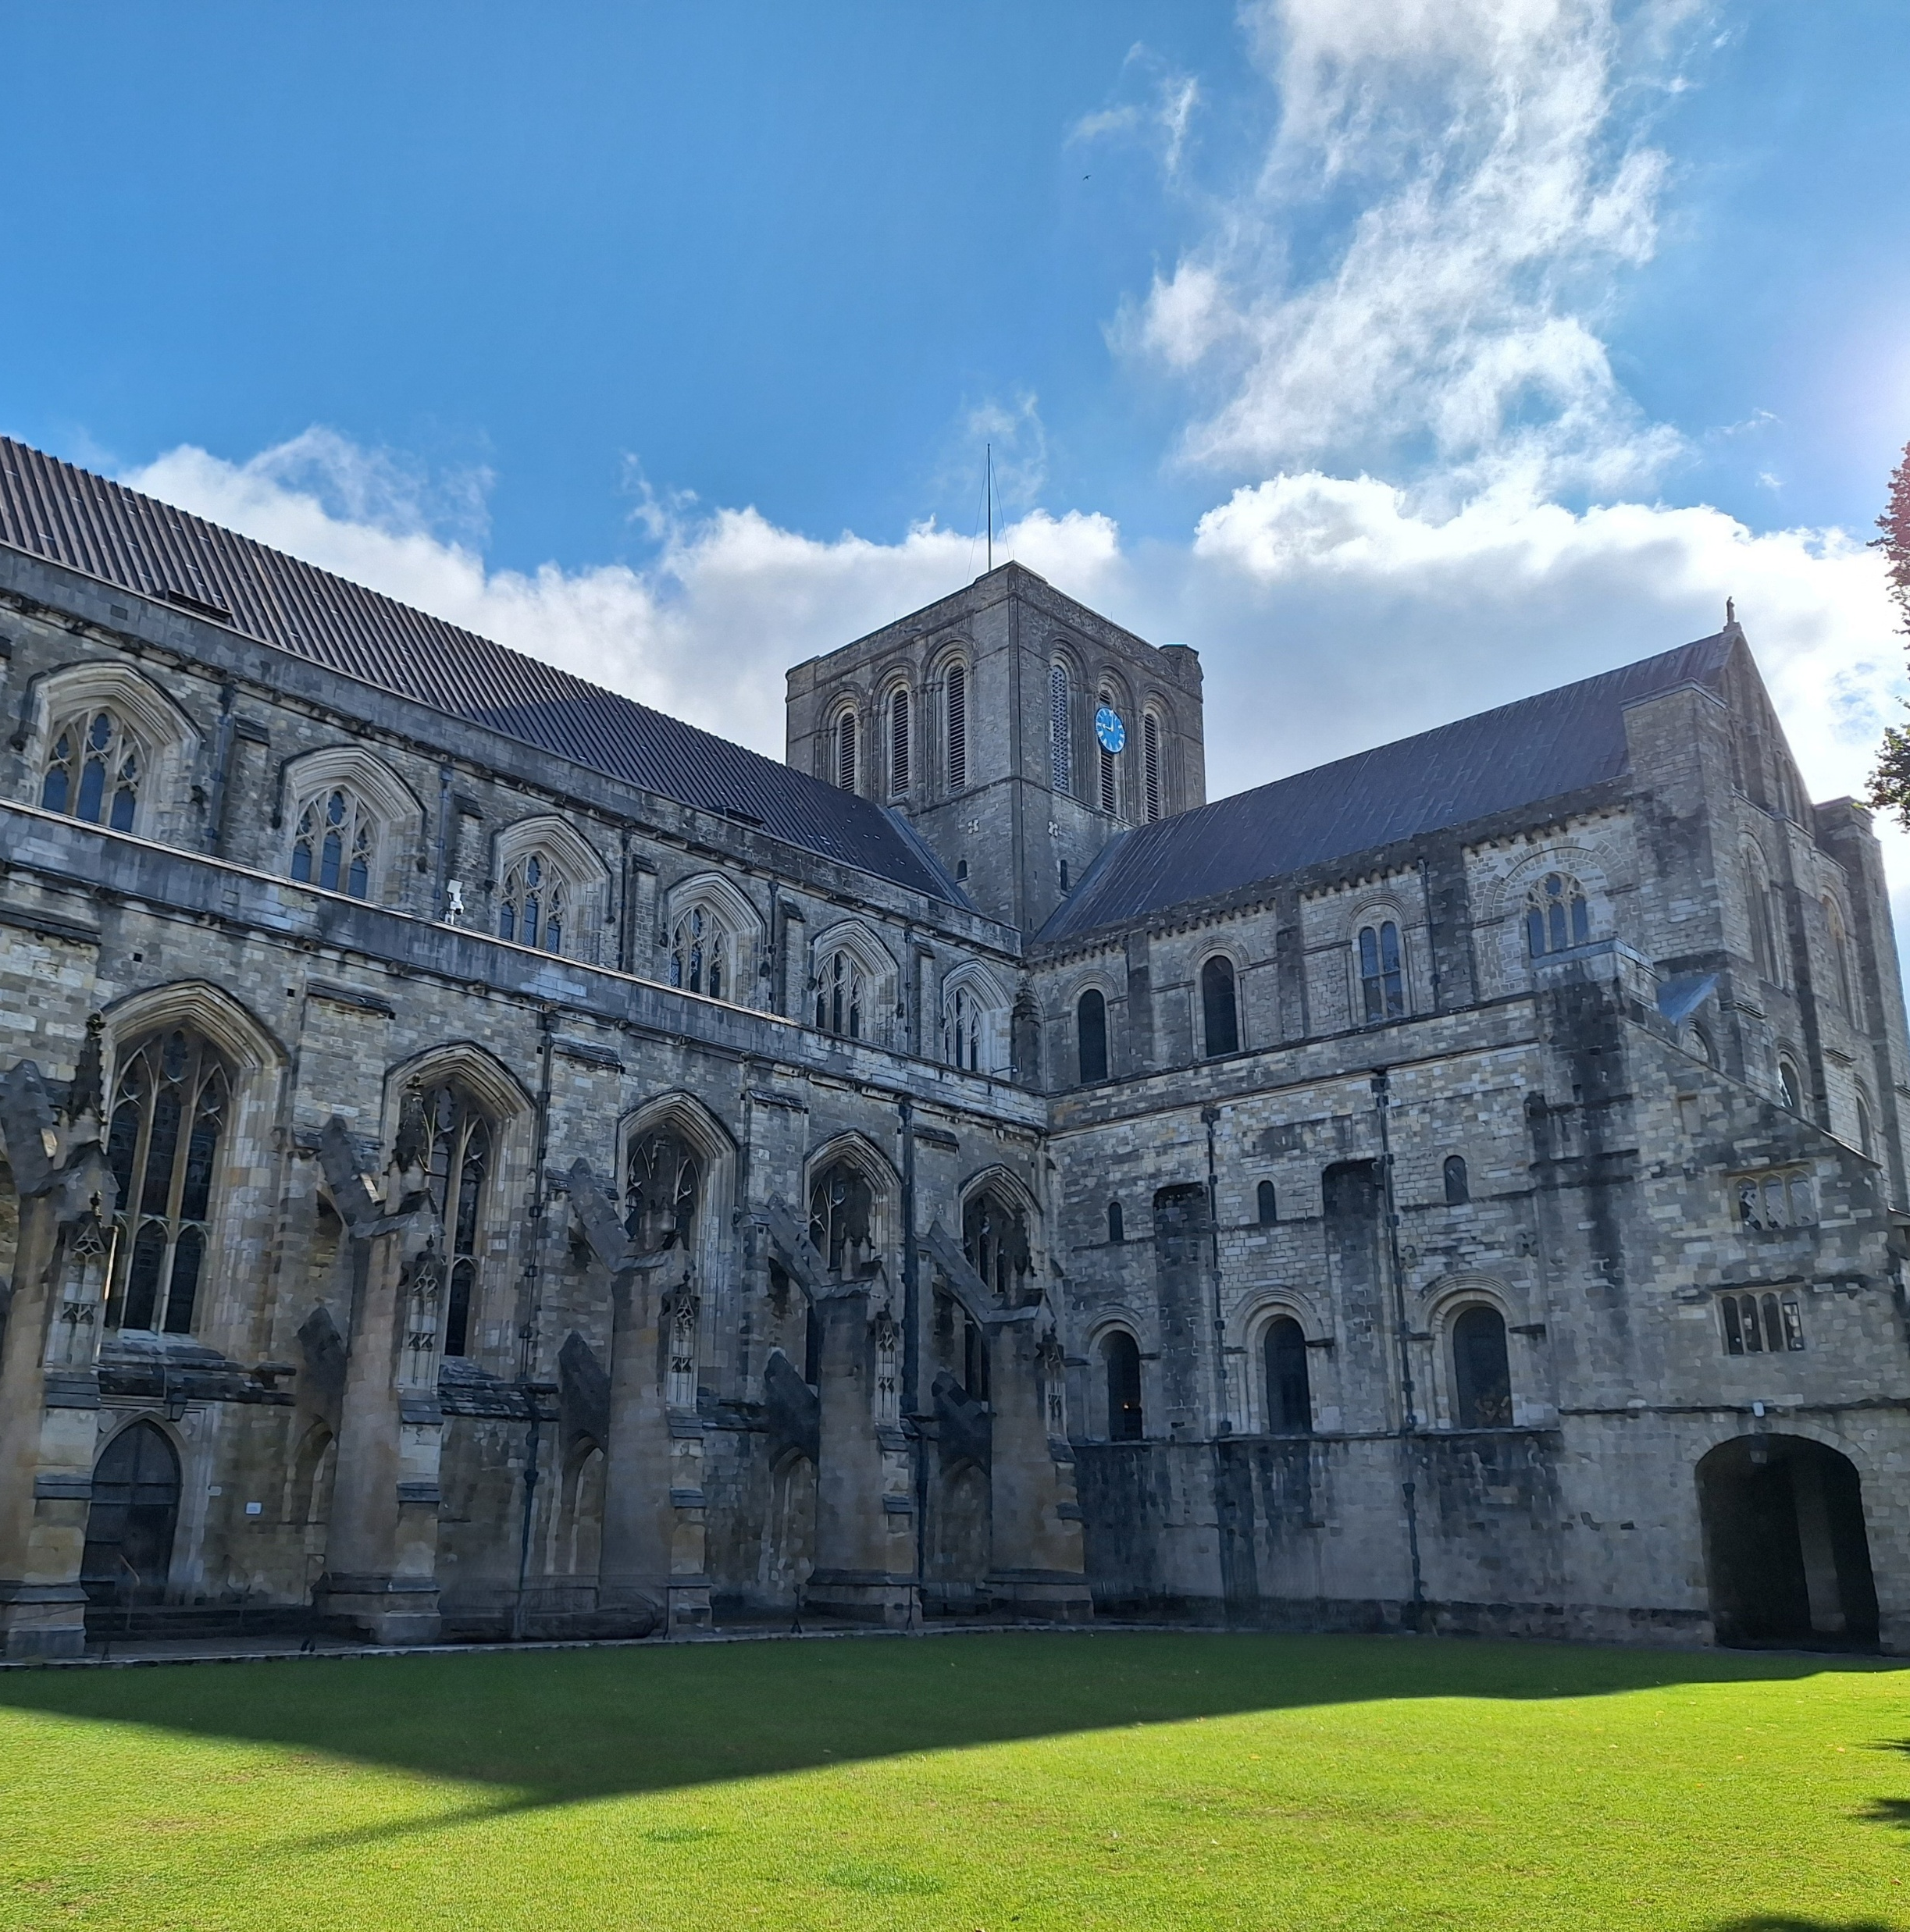
Some of the wonderful sights on my journey in to work!

Slide 4
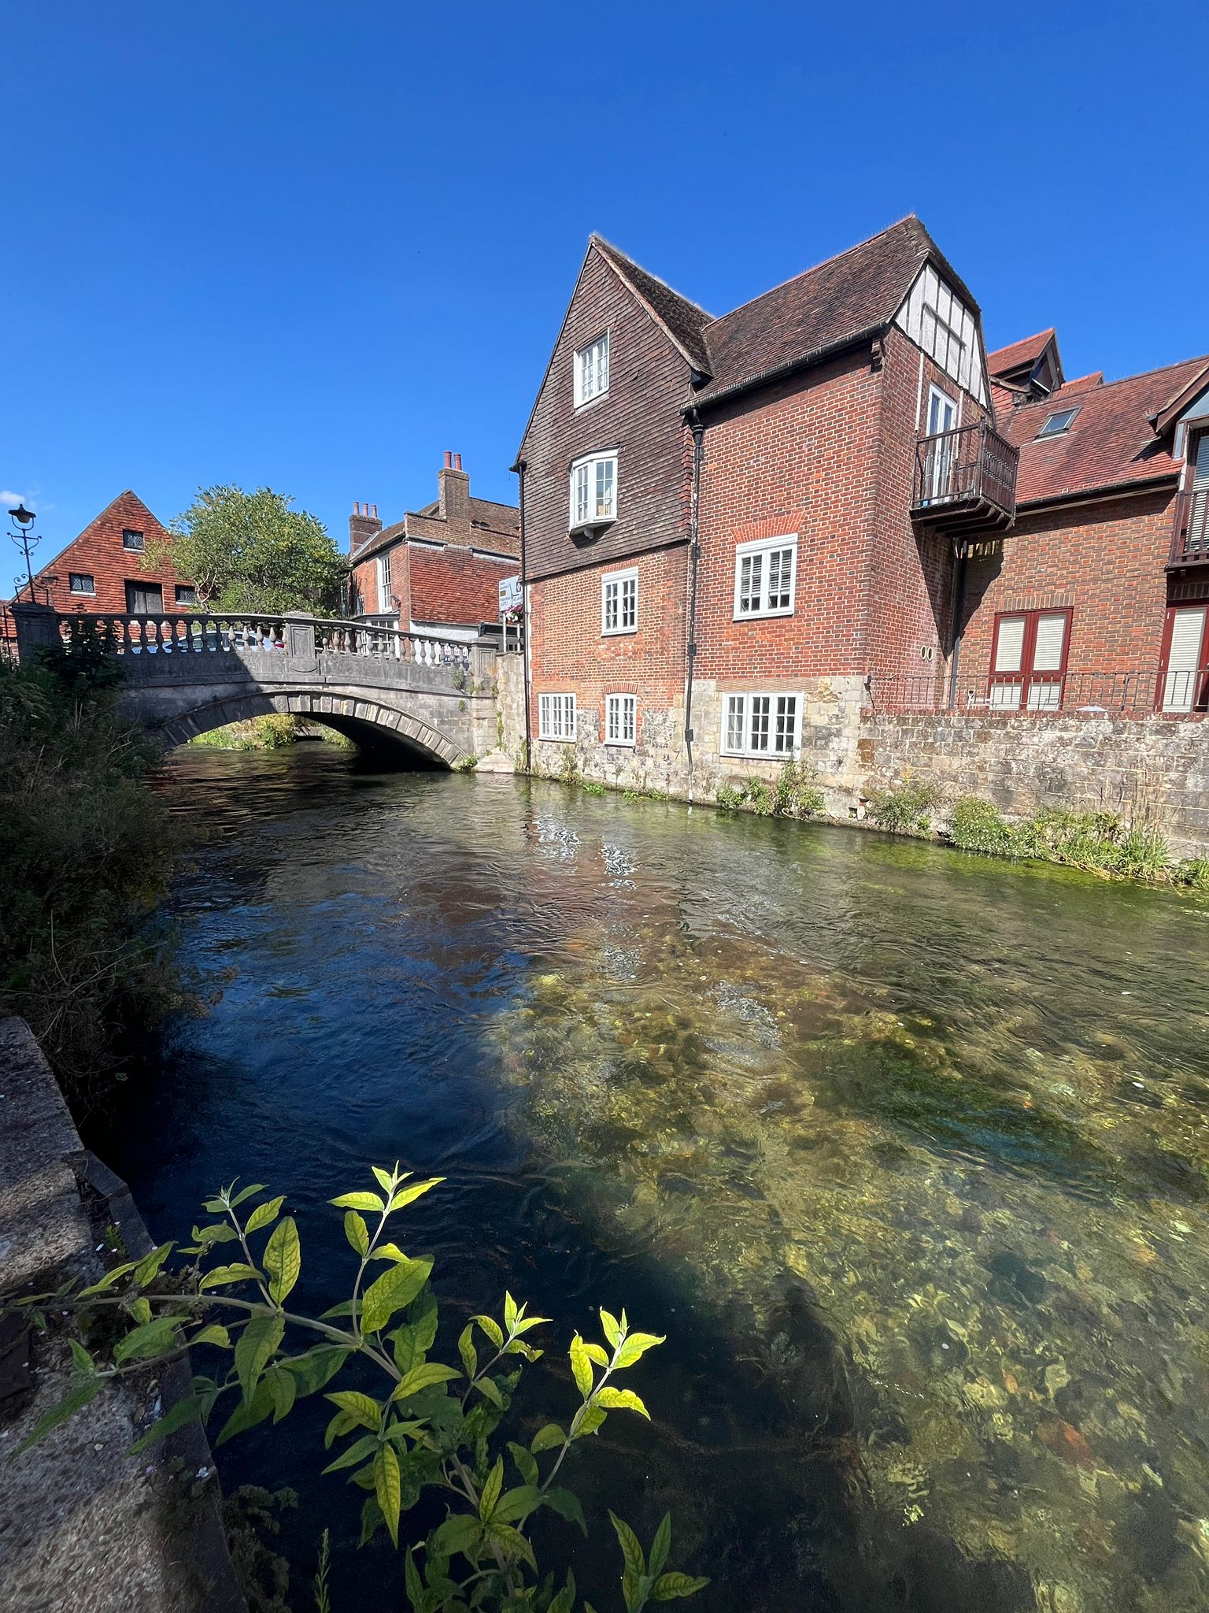

The walk back via The Weirs – beautiful! 💖
You get to see lovely art like this that you would miss if you were in a car!

